Slide 1


PPSD 23-24 RICAS, SAT, and Attendance
School Board
11.20.2024

Slide 2
PPSD Compared to State

Slide 3
PPSD Overall Performance
Providence was the only district in the state to maintain and grow in all monitored areas.
Reduced Chronic Absenteeism
Reached a Higher Rate of Individual Student Growth
Increased in Math on RICAS & SAT
Increased in ELA on RICAS & SAT

Slide 4
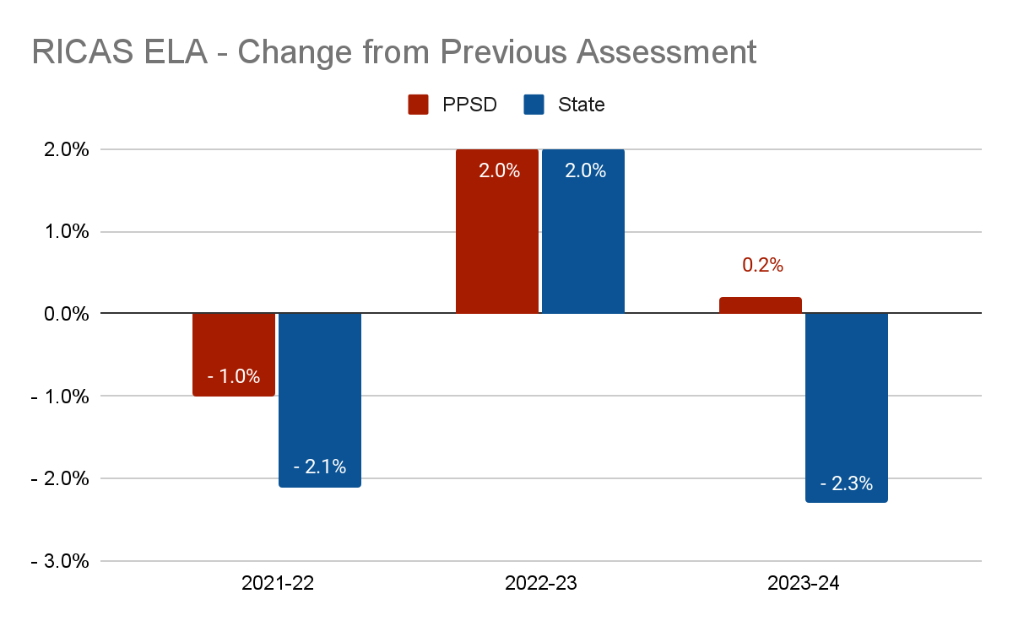
RICAS ELA Change - PPSD vs State
In 22-23 both PPSD and the State grew at the same rate of 2 percentage points.
PPSD maintained the same rate of proficiency in 23-24 while the state had its second highest drop since the pandemic.
Notes:
PPSD showed growth two years in a row. While the growth this year was not significant, it's important to note that the state lost considerable progress this year which PPSD did not.

Slide 5
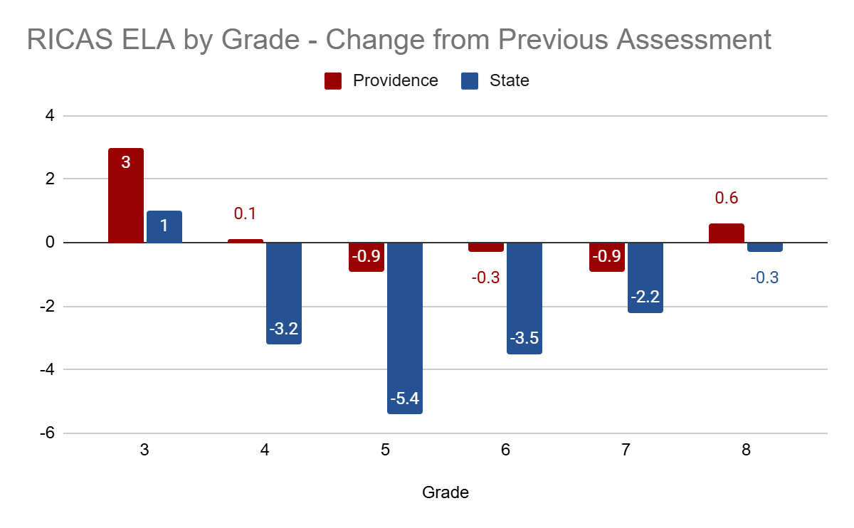
RICAS ELA Change - PPSD vs State
In every grade PPSD either saw larger gains in ELA than the state average or showed significantly smaller declines when compared to the drastic performance drops in the state average.

Slide 6

RICAS ELA Change - PPSD vs Similar Districts
 | Central Falls | Providence | Newport | Pawtucket | Woonsocket
% FRL | 88% | 75% | 67% | 63% | 59%
Change in Percent Meeting Or Exceeding Expectations from 2023 to 2024 | -0.8🔻 | 0.2 | 2.5 | -0.9🔻 | -3.2🔻
Notes:
Of school districts with similar percentages of students receiving free or reduced lunch, PPSD saw the second highest achievement and second highest growth rate (and again, this growth rate is not significant, but stands in comparison to the decreases seen across the state.)

Slide 7
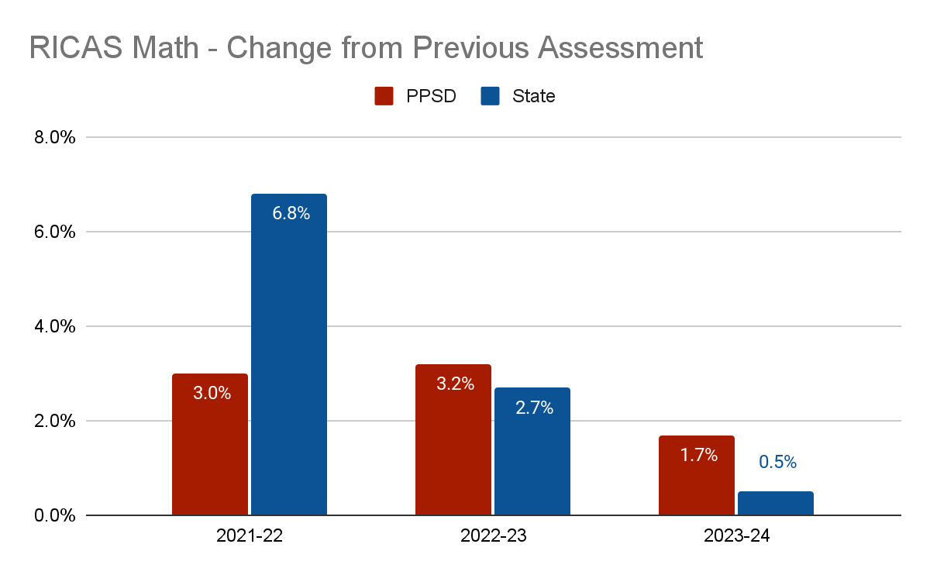
RICAS Math Change - PPSD vs State
In 22-23 PPSD grew slightly more than the state.
In 23-24 PPSD continued to grow at a faster rate than the state, continuing to close the gap between the two.

Slide 8
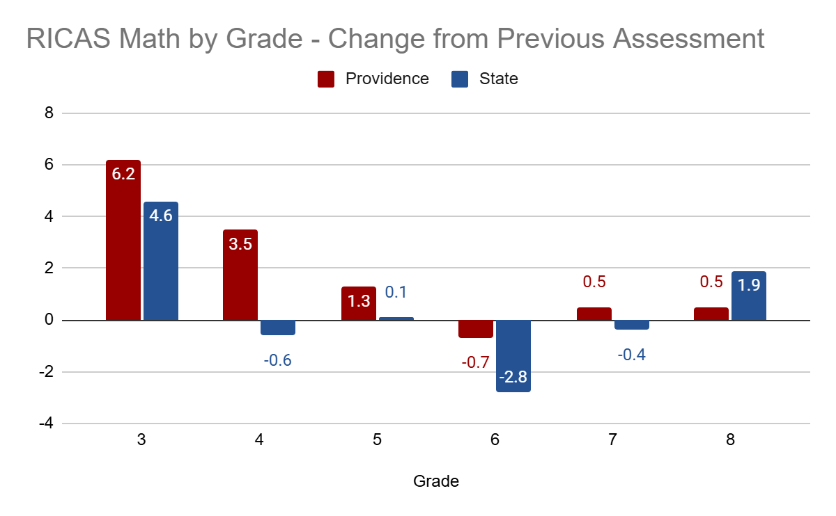
RICAS Math Change - PPSD vs State
In nearly every grade PPSD either saw larger gains in Math than the state average or showed significantly smaller declines when compared to the drastic performance drops in the state average.
We are particularly proud of the growth in Elementary math.

Slide 9
RICAS Math Change - PPSD vs Similar Districts
 | Central Falls | Providence | Newport | Pawtucket | Woonsocket
% FRL | 88% | 75% | 67% | 63% | 59%
Change in Percent Meeting Or Exceeding Expectations from 2023 to 2024 | ** | 1.7 | 1.6 | .6 | -1.1🔻

Slide 10
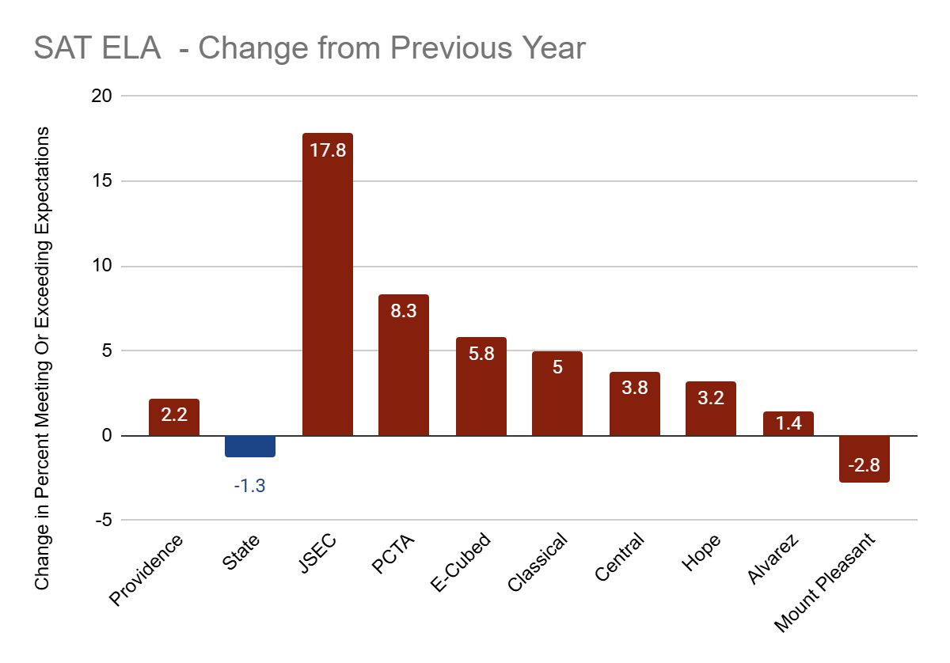
SAT ELA - Change in Proficiency
PPSD saw an increase of 2.2 percentage points in students meeting expectations on the ELA portion of the SAT.

Slide 11
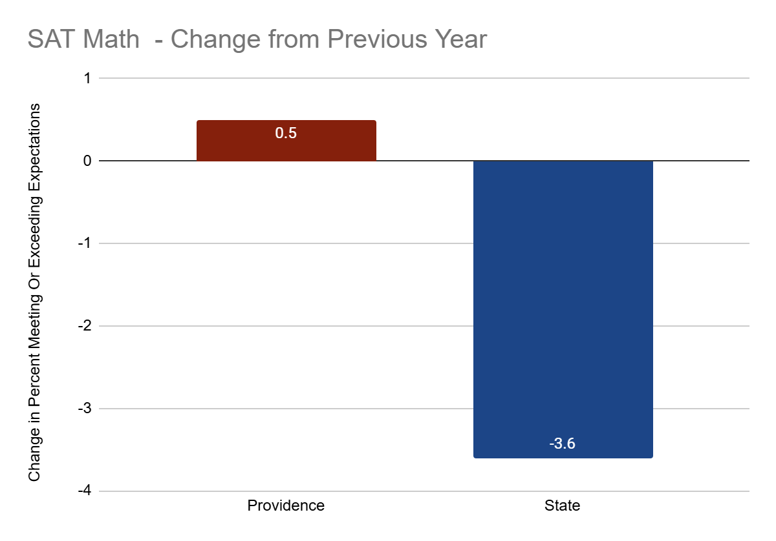
SAT Math - Change in Proficiency
Despite a drastic statewide decrease, PPSD maintained a consistent percentage of students meeting expectations on the SAT Math.
Notably, two schools increased from less than 5% proficiency the previous year: JSEC at 8.9% and PCTA at 11.5%.

Slide 12
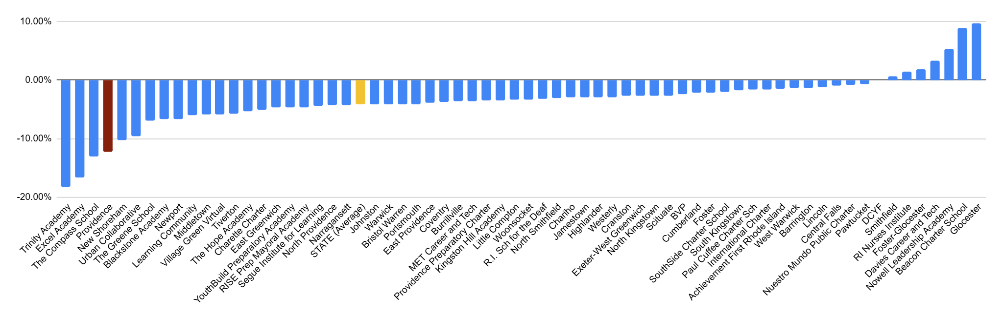
Changes in Chronic Absenteeism by District
PPSD saw a larger decrease in chronic absenteeism this year than 95% of RI School Districts.

Slide 13
PPSD RICAS & SAT Performance

Slide 14
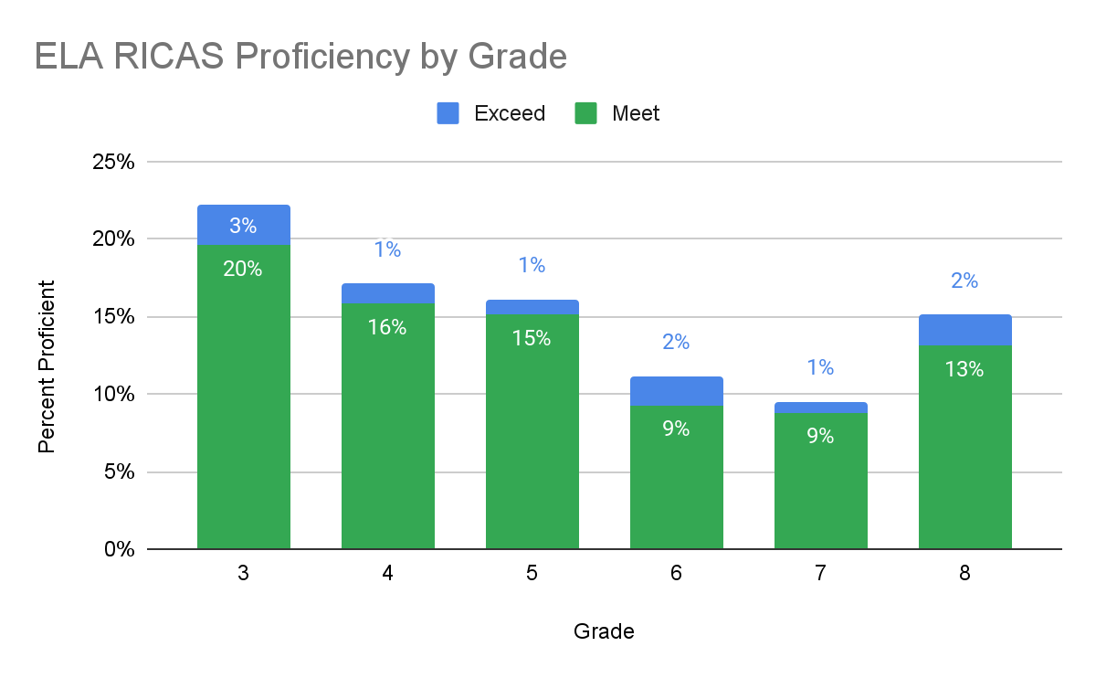
RICAS ELA

Slide 15
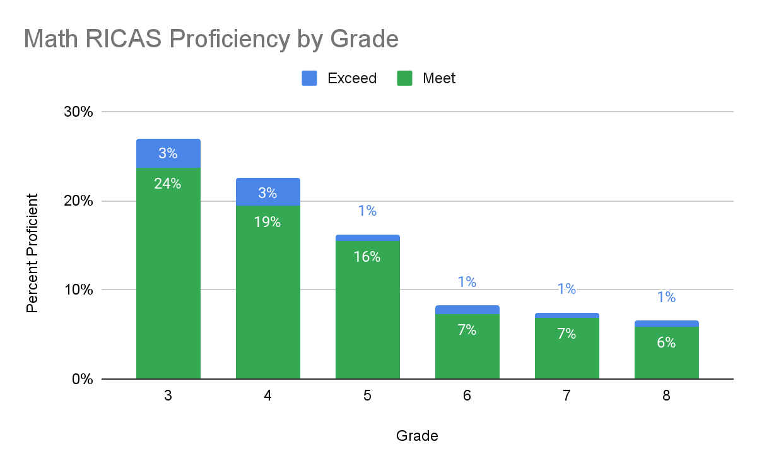
RICAS Math

Slide 16
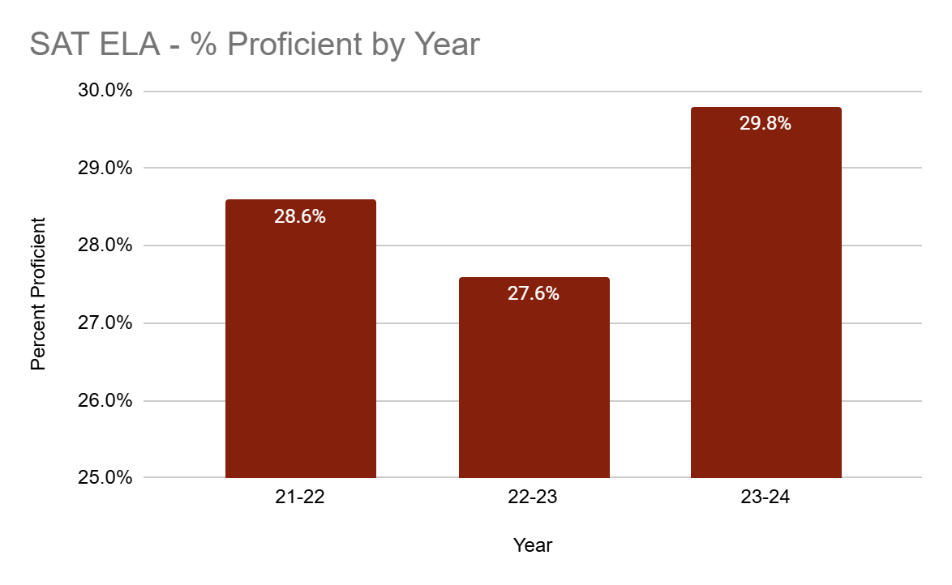
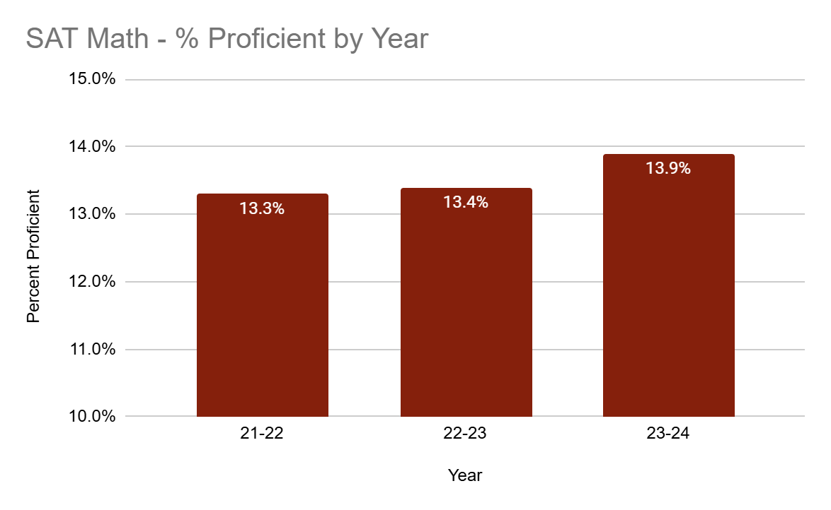
SAT
PPSD's SAT scores have increased in both ELA and Math.
The ELA proficiency rate of 29.8% is the highest for PPSD since the state began using the SAT as its assessment in 2017-2018.

Slide 17

Spotlight Schools
RICAS Highlights
Asa Messer - Math increase of 12.1 percentage points, ELA increase of 23.4 percentage points.
Kennedy - Math increase of 11.1 percentage points.
Veazie - Math increase of 10.6 percentage points.
SAT Highlights
JSEC - Math increase of 8.9 percentage points, ELA increase of 17.8 percentage points.
PCTA - Math increase of 7.5 percentage points, ELA increase of 8.3 percentage points.
Classical - Math proficiency of 60.1% (1.8% higher than last year), ELA proficiency rate of 88.8% (5% higher than last year).

Slide 18
PPSD
Attendance

Slide 19
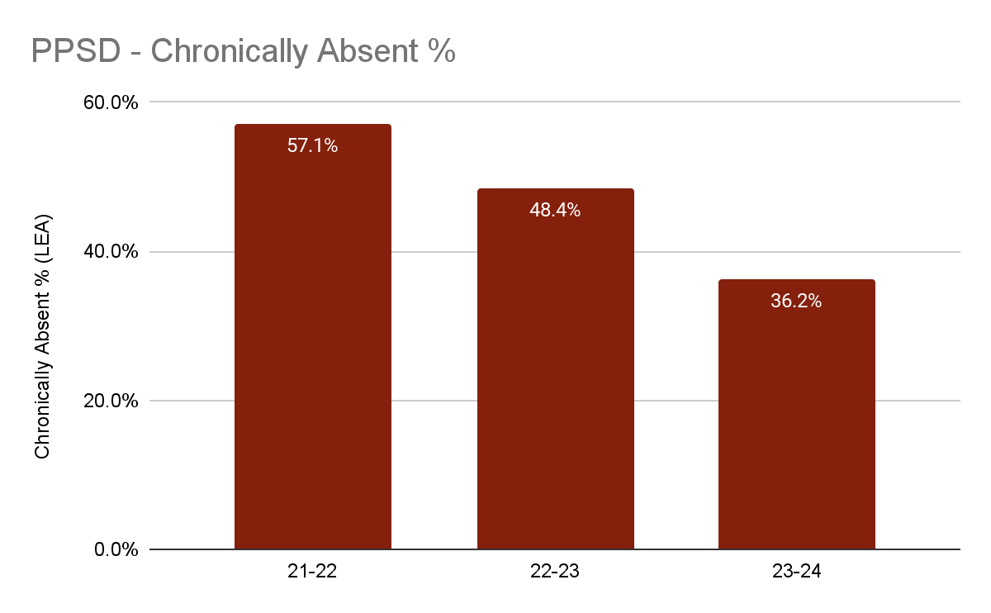
PPSD - Chronic Absenteeism by Year
PPSD has shown a consistent improvement in decreasing the rate of chronic absenteeism.
Last year the percent of students chronically absent reached 36% bringing us to our pre-pandemic levels.

