Slide 1



Health and Wellness Committee
Food Service Update
September – February 2025
March 25th 2025
Brett Nadeau, Resident District Manager
Nedge Pierre Louis, Registered Dietitian
1
Health & Wellness Review | March 2025

Slide 2
AGENDA
Participation Numbers
RI Recycling and Boot Strap Composting
Taste Tests and Nutrition Education
Backpackers Program
2
Health & Wellness Review | March 2025

Slide 3
PARTICIPATION NUMBERS
September through February
Summary of Grade Level |  | Enrollment | Attendance % YTD | Attendance YTD AVG | Breakfast Per Day YTD | Breakfast Participation AVG | Lunch Per Day YTD | Lunch Participation AVG
Elementary Level |  | 9,069 | 91.92% | 8,336 | 7,174 | 86.06% | 6,259 | 87.25%
Middle School Level |  | 4,120 | 90.00% | 3,708 | 1,273 | 34.33% | 2,619 | 70.63%
High School Level |  | 6,623 | 85.82% | 5,684 | 1,972 | 34.69% | 3,487 | 61.35%
Totals |  | 19,812 | 89.48% | 17,728 | 10,419 | 58.77% | 12,365 | 69.75%
3
Health & Wellness Review | March 2025

Slide 4
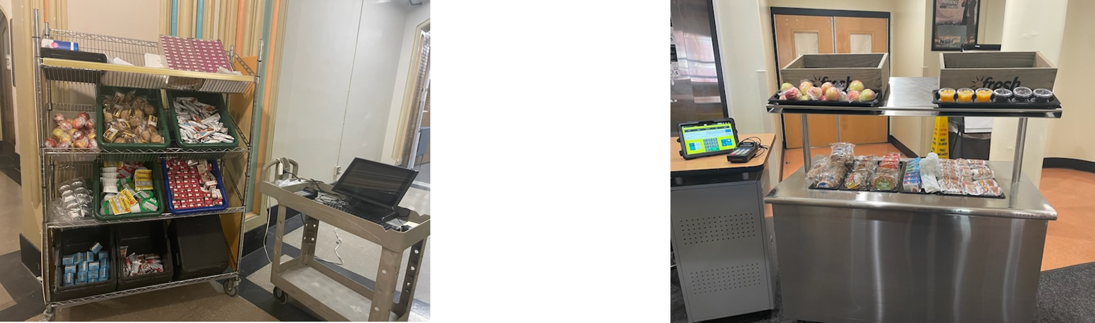
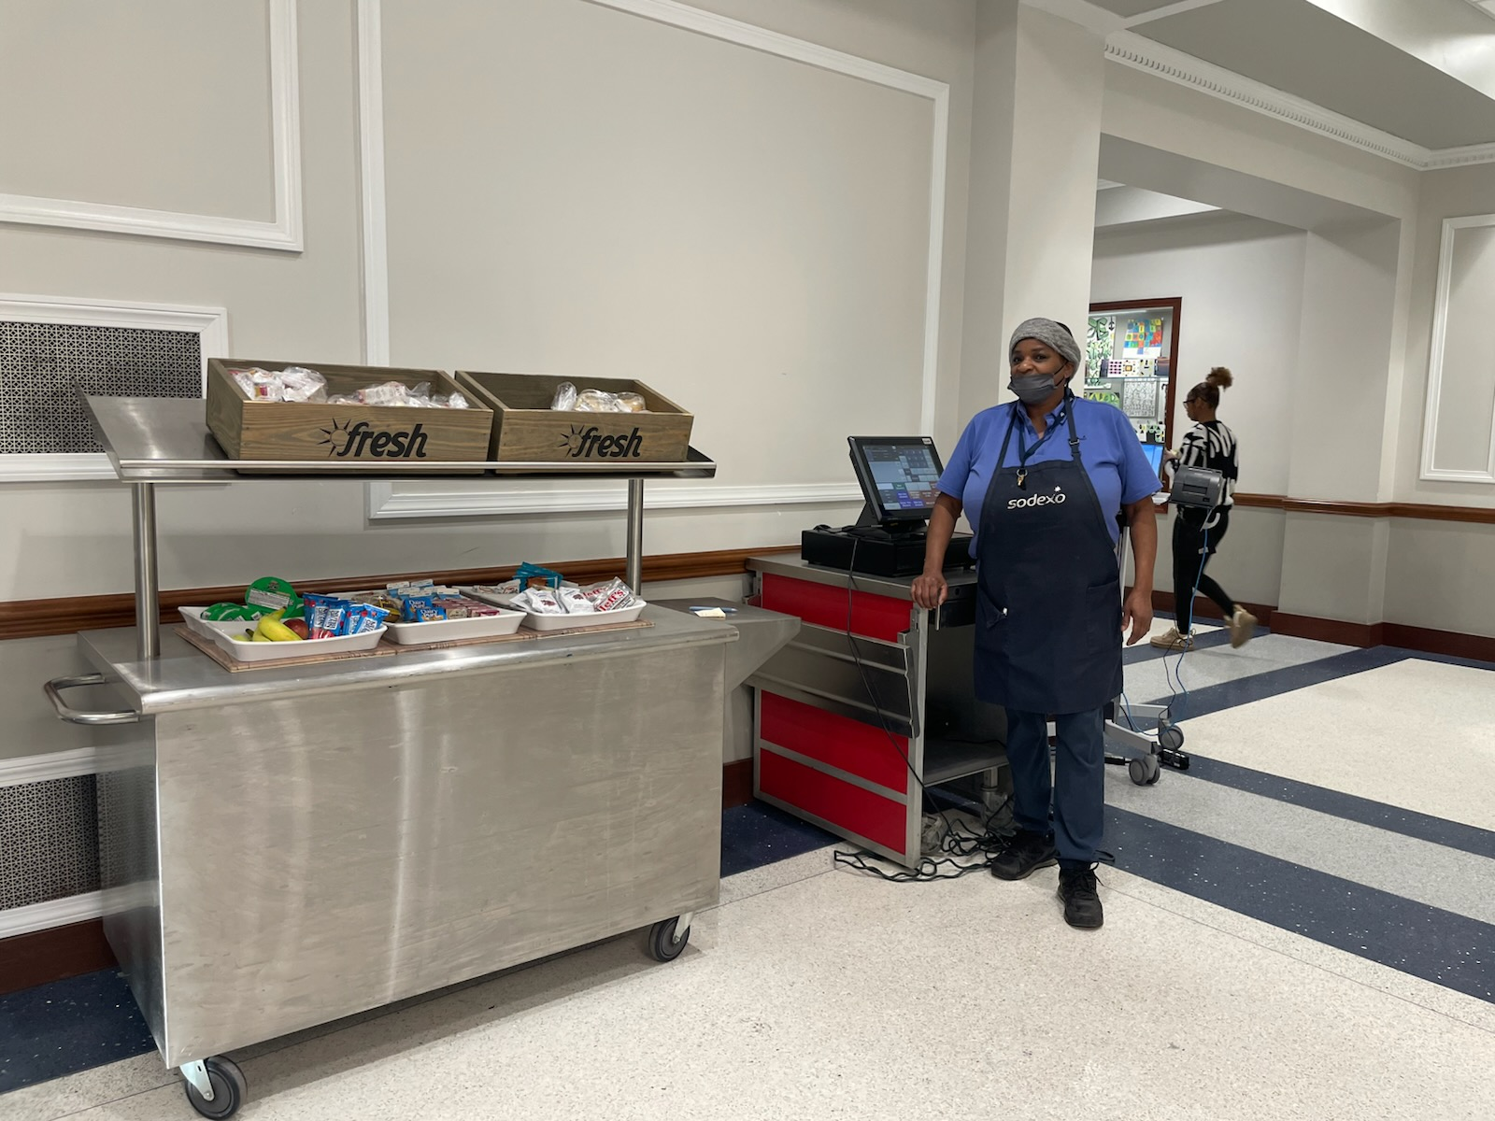
Grab and Go Breakfast Program
Secondary students arrive by bussing and public transporation,
often results in non-personal tardeeism
Identified need to serve students breakfast where/when
they are entering schools
Nathanael Greene Middle School
Hope High School
Central High School
4
Health & Wellness Review | March 2025

Slide 5
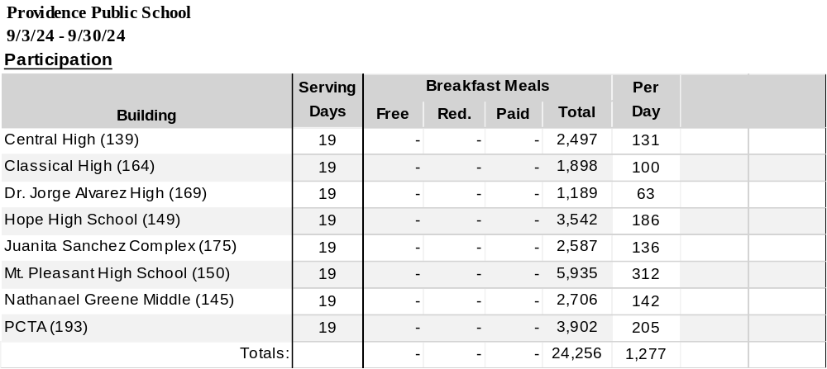
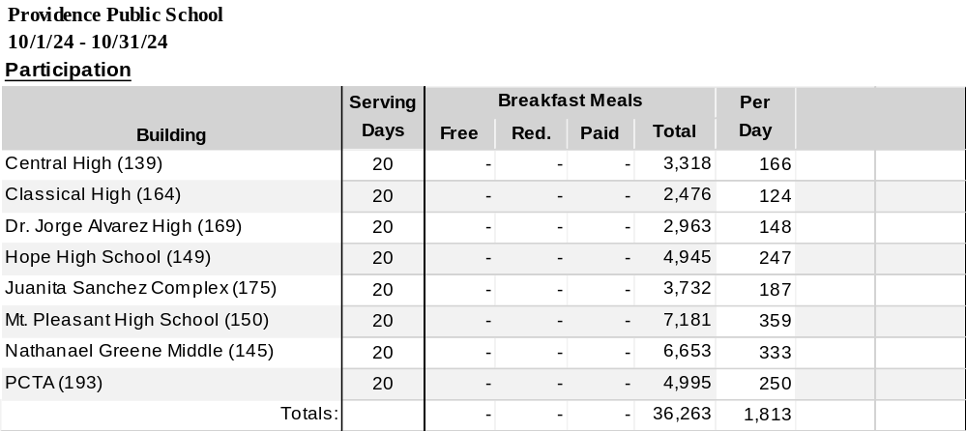
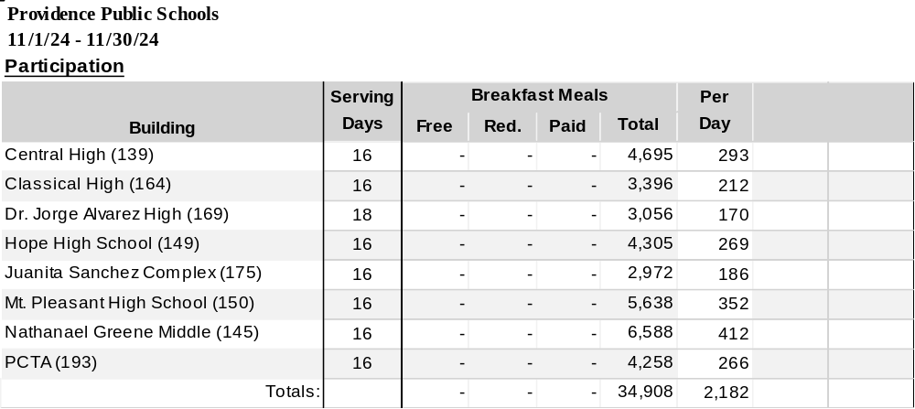

Grab and Go Breakfast Program
5
Health & Wellness Review | March 2025

Slide 6
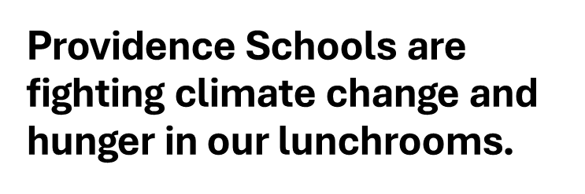

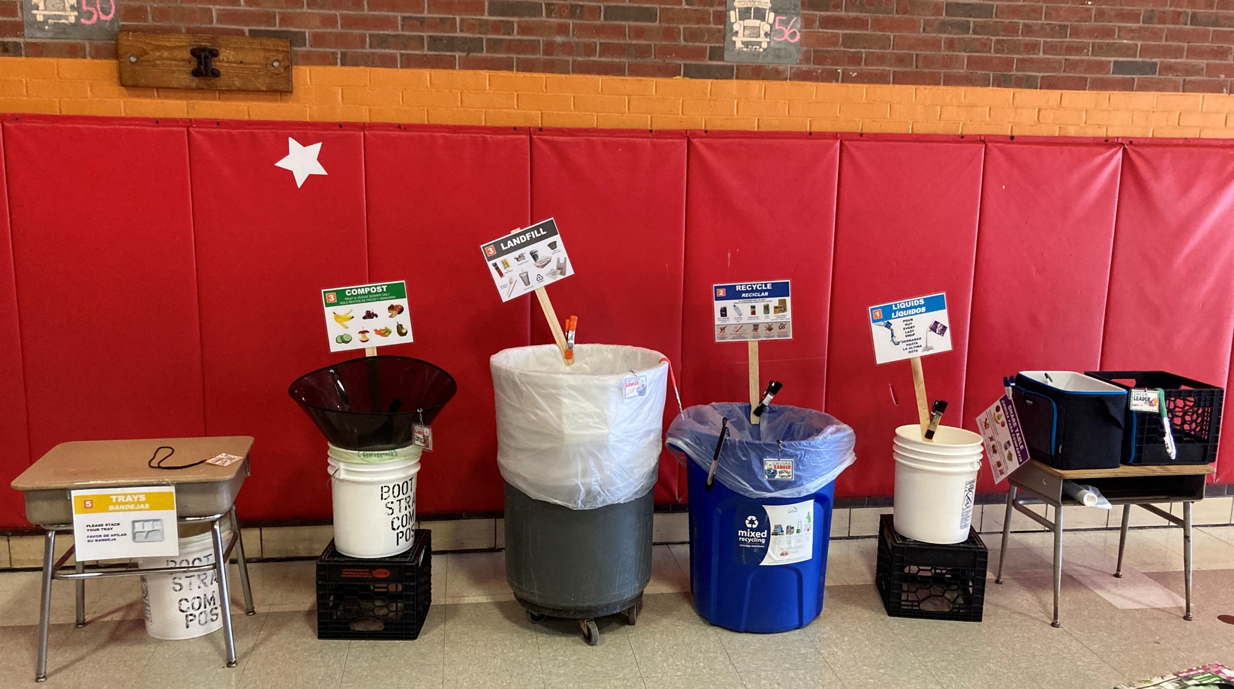
RECYCLING AND COMPOSTING
All
PPSD schools are participating in back of the house composting
11
Schools are participating in student front of the house composting
Sackett
George West
Asa Messer
Webster Ave
Young Woods
Nathan Bishop
Spaziano
Vartan
Gregorian
Dual Language
King
D’Abate
More schools rolling out this Spring:
Pleasant View Bailey
Carnevale Fogarty
Reservoir Lima
Kizarian
6
Health & Wellness Review | March 2025

Slide 7
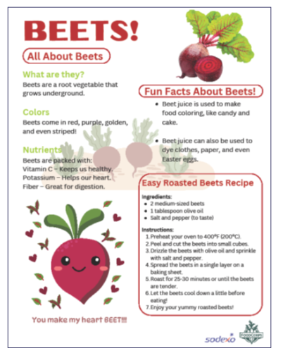
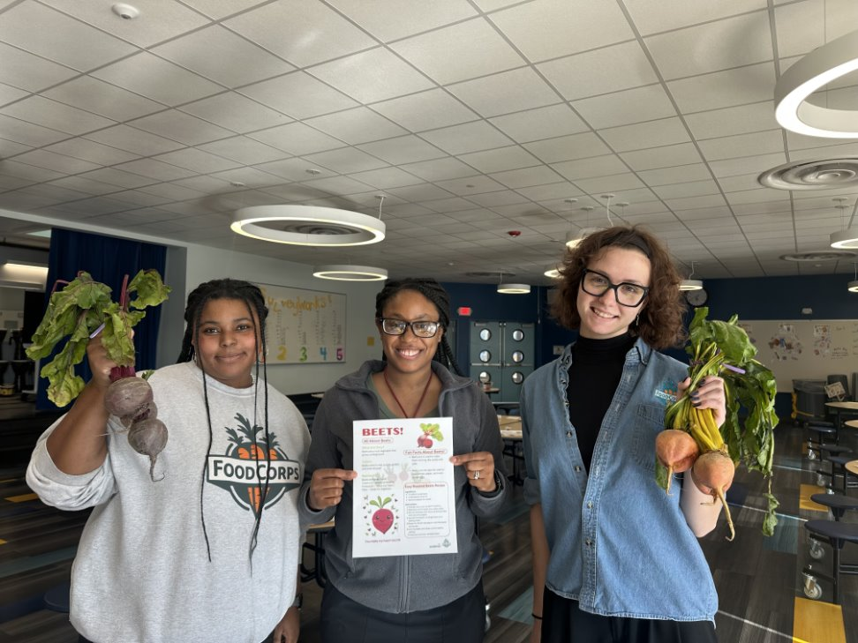
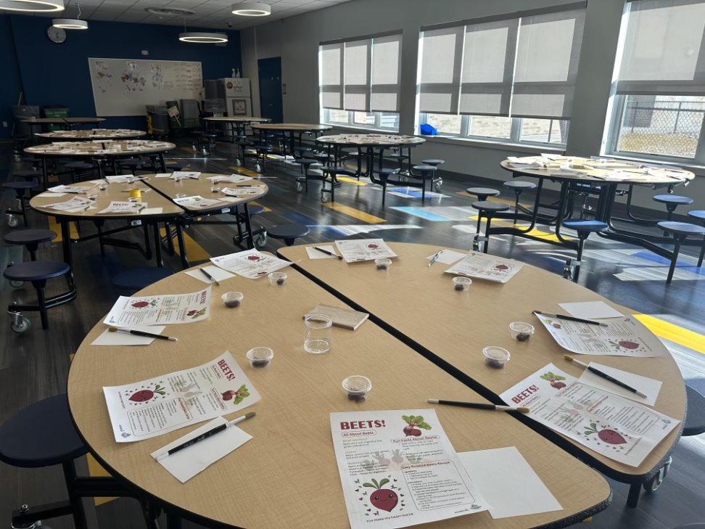
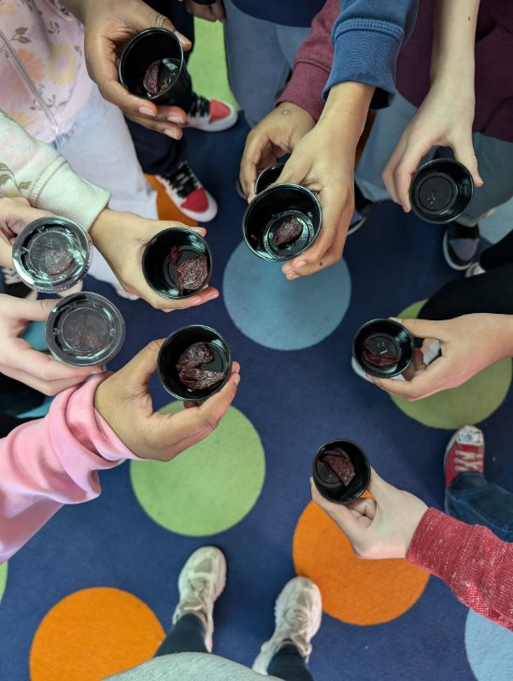
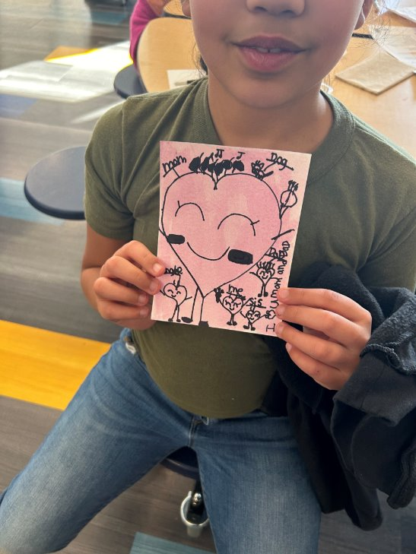
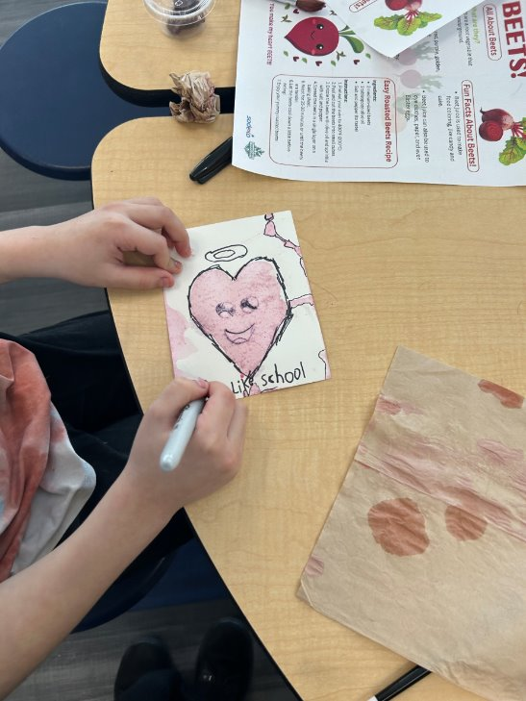
TASTE TESTS & NUTRITION EDUCATION
Exploring Beets!
Nutrition Lesson, Taste & Paint with MLK & D’Abate
7
Health & Wellness Review | March 2025

Slide 8
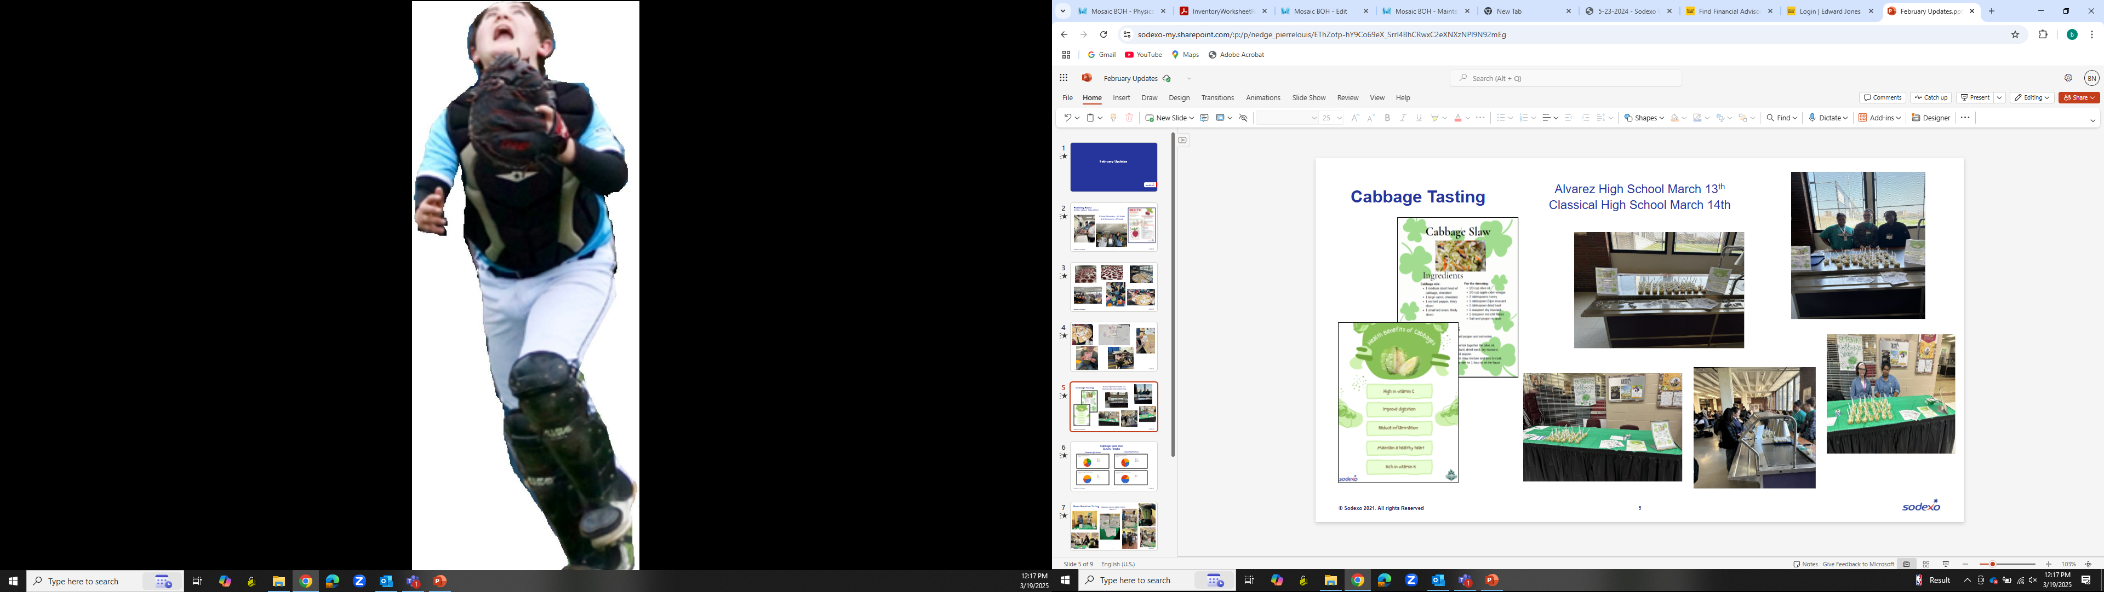
TASTE TESTS & NUTRITION EDUCATION
8
Health & Wellness Review | March 2025

Slide 9
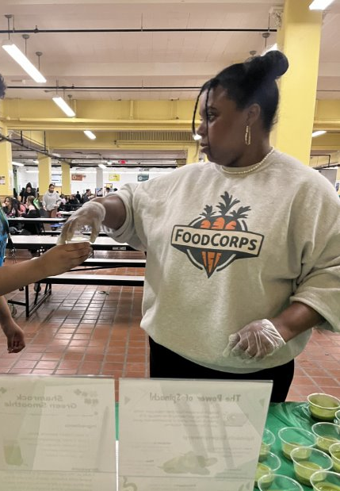
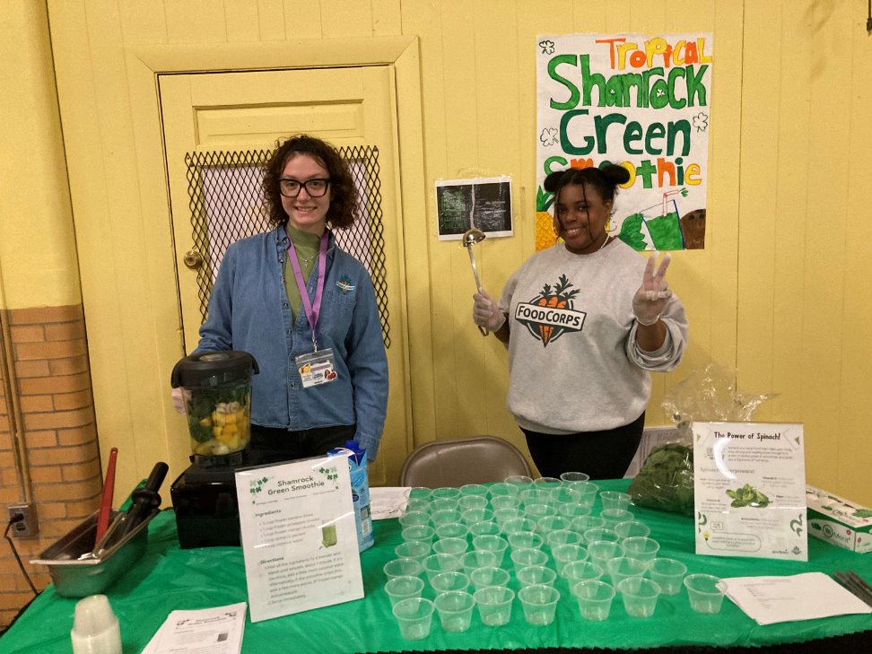
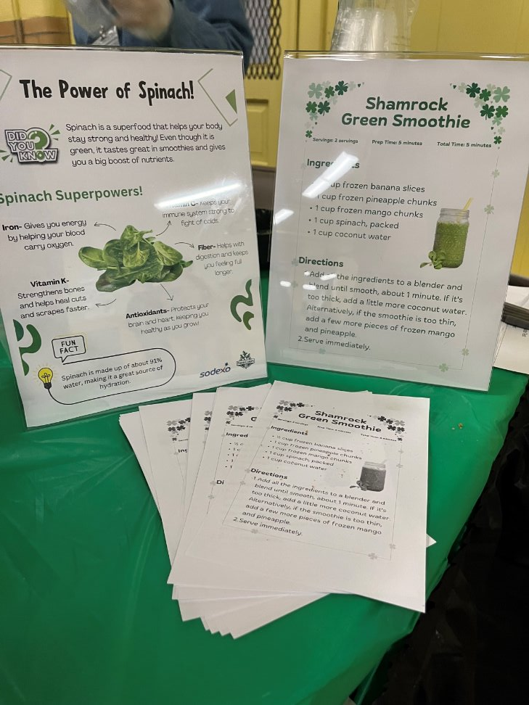
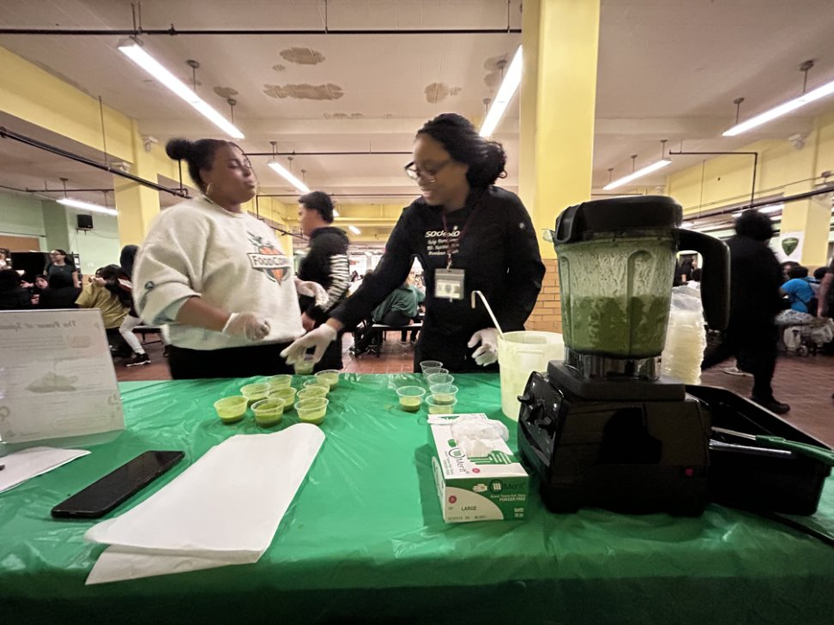
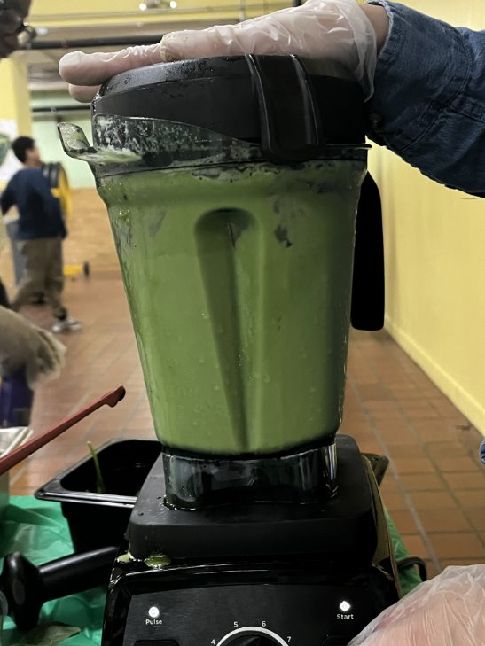
TASTE TESTS & NUTRITION EDUCATION
Green Smoothie Tasting
Nathanael Greene Middle School
March 17th
9
Health & Wellness Review | March 2025

Slide 10
WEEKEND BACKPACKER PROGRAM UPDATE
October through early March
3,517 backpacks sent home
201 turkey baskets sent
over the holidays
Partnered in beginning of this year with Amenity Aid
  Bars of soap / body wash
  Toothpaste / toothbrushes
  Deodorant
Weekend Backpacker Program
Newcomers Roger Williams
PCTA Kizarian
West Broadway Pleasant View
Carnevale Spaziano
Central Cuffee Elementary
Sackett Asa Messer
Dual Language Sanchez
Young Woods Hope
Reservoir Webster
Kennedy
10
Health & Wellness Review | March 2025

Slide 11
THANK YOU
11
Health & Wellness Review | March 2025

