Slide 1


Providence Public Schools
School Board Updates
December 2024

Slide 2
      Agenda
      Financial settlement with City of Providence
      Capital plan and swing space update

Slide 3
Financial Settlement
Settlement was for two separate legal actions taken by the City of Providence against the Commissioner for withholding funds due to the City’s failure to meet their statutory obligation
      PPSD and the City of Providence had two separate pending legal matters: 1) FY24 City contribution; and 2) FY25 City contribution
      On November 8, Superior Court Judge Lanphear ruled in favor of PPSD, confirming that the City had failed to meet their funding obligation to PPSD and that the Commissioner had the authority to withhold funds
      Judge’s decision confirmed PPSD’s calculation for maintenance of effort
      Judge scheduled a hearing to set the exact amount of funds owed
Prior to the Judge setting the amount, the parties engaged in negotiations and ultimately reached a settlement agreement

Slide 4
Financial Settlement
Settlement covers four fiscal years
FY24
FY25
FY26
FY27
$4M
($134M total)
$8M + $3M in energy credits
($143.5M total + $3M expense reduction)
$147M total
$147M + % increase in state aid
Less than $148M budgeted and $155.6M owed
PPSD will close remaining gap with reserves and ESSER indirect
Allows PPSD to balance budget; less than $162.2M owed
$0.5M net increase in revenue/expenses from FY25
Current fiscal year

Slide 5
Financial Settlement
Settlement enables PPSD to avoid FY25 cuts and provides clarity for the future
Benefits
Additional Considerations
PPSD will avoid significant reductions to transportation, sports, and staffing
Both PPSD and City have greater clarity on funding for this year and future years, avoiding uncertainty that the district has faced in each year of the intervention
Provides for increases in FY27 based on state aid increases
No additional funding to reverse cuts already made
PPSD must significantly reduce reserves in order to close out FY24
PPSD will need to keep spending freeze in place to address costs from IT incident
PPSD anticipates a challenging FY26 with flat City funding compared FY24 and FY25 and difficult early state aid projections
PPSD continues to see increased student need and will also be negotiating contracts for all bargaining units

Slide 6
Financial Settlement
Next steps
      PPSD is in early stages of planning for FY26, using revenue and expense projections to determine overall financial picture
      In January and February we will work with schools to plan school budgets
      We will continue to provide updates at School Board Finance and School Board

Slide 7
      Agenda
      Financial settlement with City of Providence
      Capital plan and swing space update
        Updates on Phases 1 – 3
        Swing Space planning
        Engagement and Next Steps

Slide 8
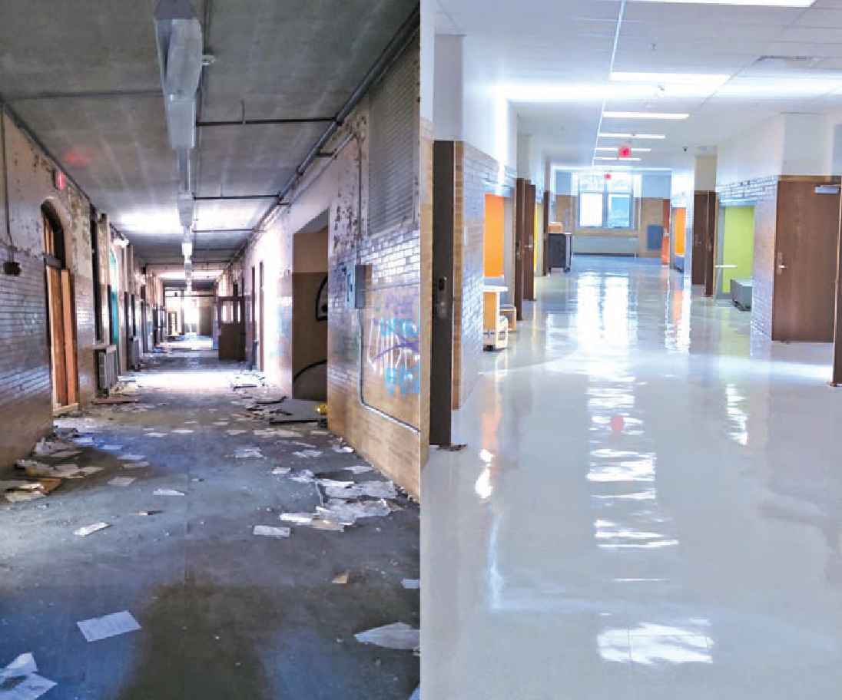
Capital Plan Priorities
We have a once-in-a-lifetime opportunity to raise expectations for what our students deserve.
Big, transformational projects for entire schools
Reimagining the middle grades experience with the Pre-K through 8 model and expanded pre-kindergarten
Newer and fewer - right-size the number of buildings for Providence’s current and projected enrollment
Build where families live, and ensure all communities
benefit from school construction
The abandoned Windmill Ave. school
Fully renovated Narducci Learning Center, reopened Fall 2023

Slide 9
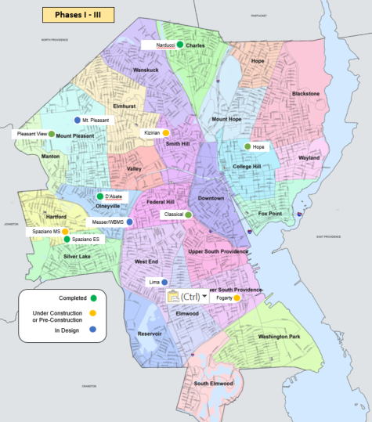
Capital Plan Phases 1 - 3: Projects Completed & Underway
Six major projects completed by Summer 2025
Project | Grades | Status
Completed
Narducci Learning Center District swing space | PK-8 | Completed Summer 2023
D'Abate Elementary School | PK-5 | Completed Fall 2023
Frank Spaziano Elementary School | PK-5 | Completed Fall 2023
Pleasant View Elementary School | PK-5 | Completed Fall 2024
In Construction
Classical High School – Phase 1 completed | 9-12 | Target Fall 2025 On track for Winter 2024
Hope High School – Phase 1 completed | 9-12 | Phase I Completed Winter 2024
 |  | Phase 2 Winter 2024
Pre-Construction
Frank Spaziano Middle School | 6-8 | Target Summer 2026
Harry Kizirian Prek-8 | PK-8 | Target Summer 2026
Fogarty Prek-8 | PK-8 | Target Summer 2026
In Design Development
Lima/Stuart PK-8 | PK-8 | Target Summer 2027
Messer / West Broadway PK-8 | PK-8 | Target Summer 2027
Mount Pleasant High School | 9-12 | Target Summer 2027

Slide 10
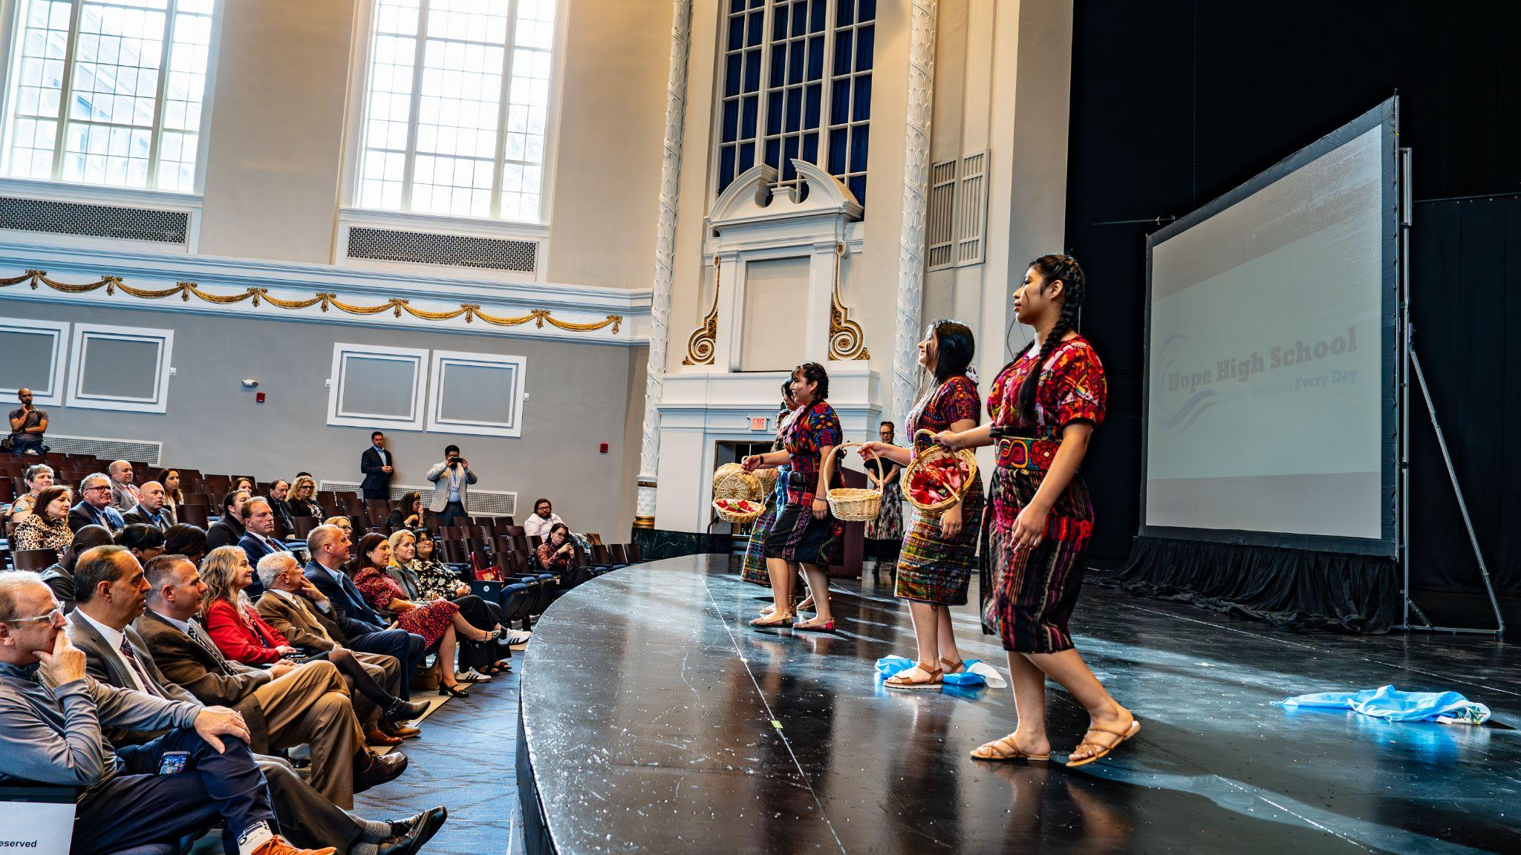
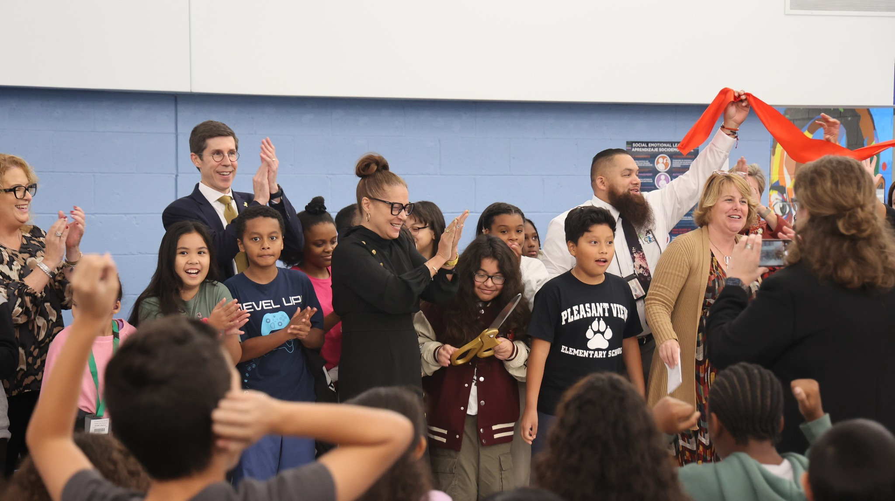
Phase 1 Projects Recently Completed
Pleasant View Elementary, Classical High, and Hope High
Design follows program:
Accessible spaces, HVAC upgrades, and indoor therapeutic spaces for Pleasant View Elementary
Dance studio for Hope High School
Hope High School renovated auditorium arts event, Fall 2025
Ribbon cutting for Pleasant View Elementary, fall 2025

Slide 11
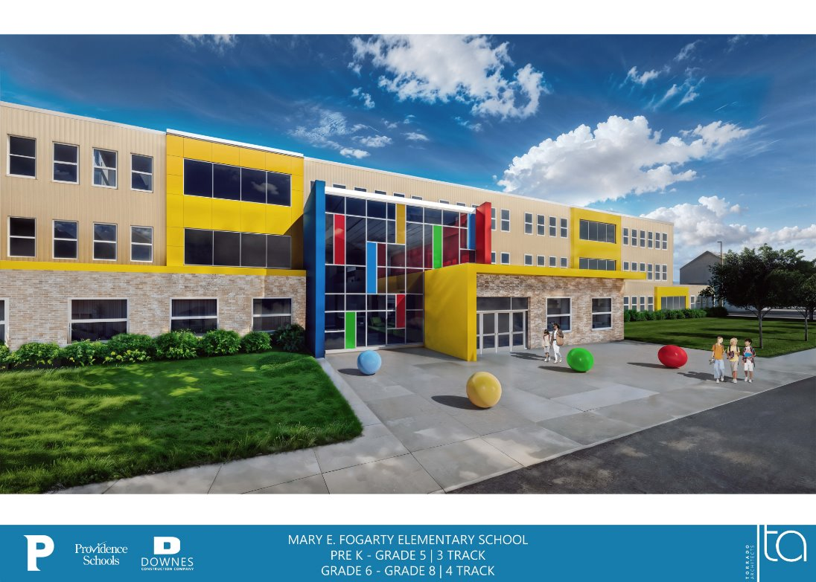
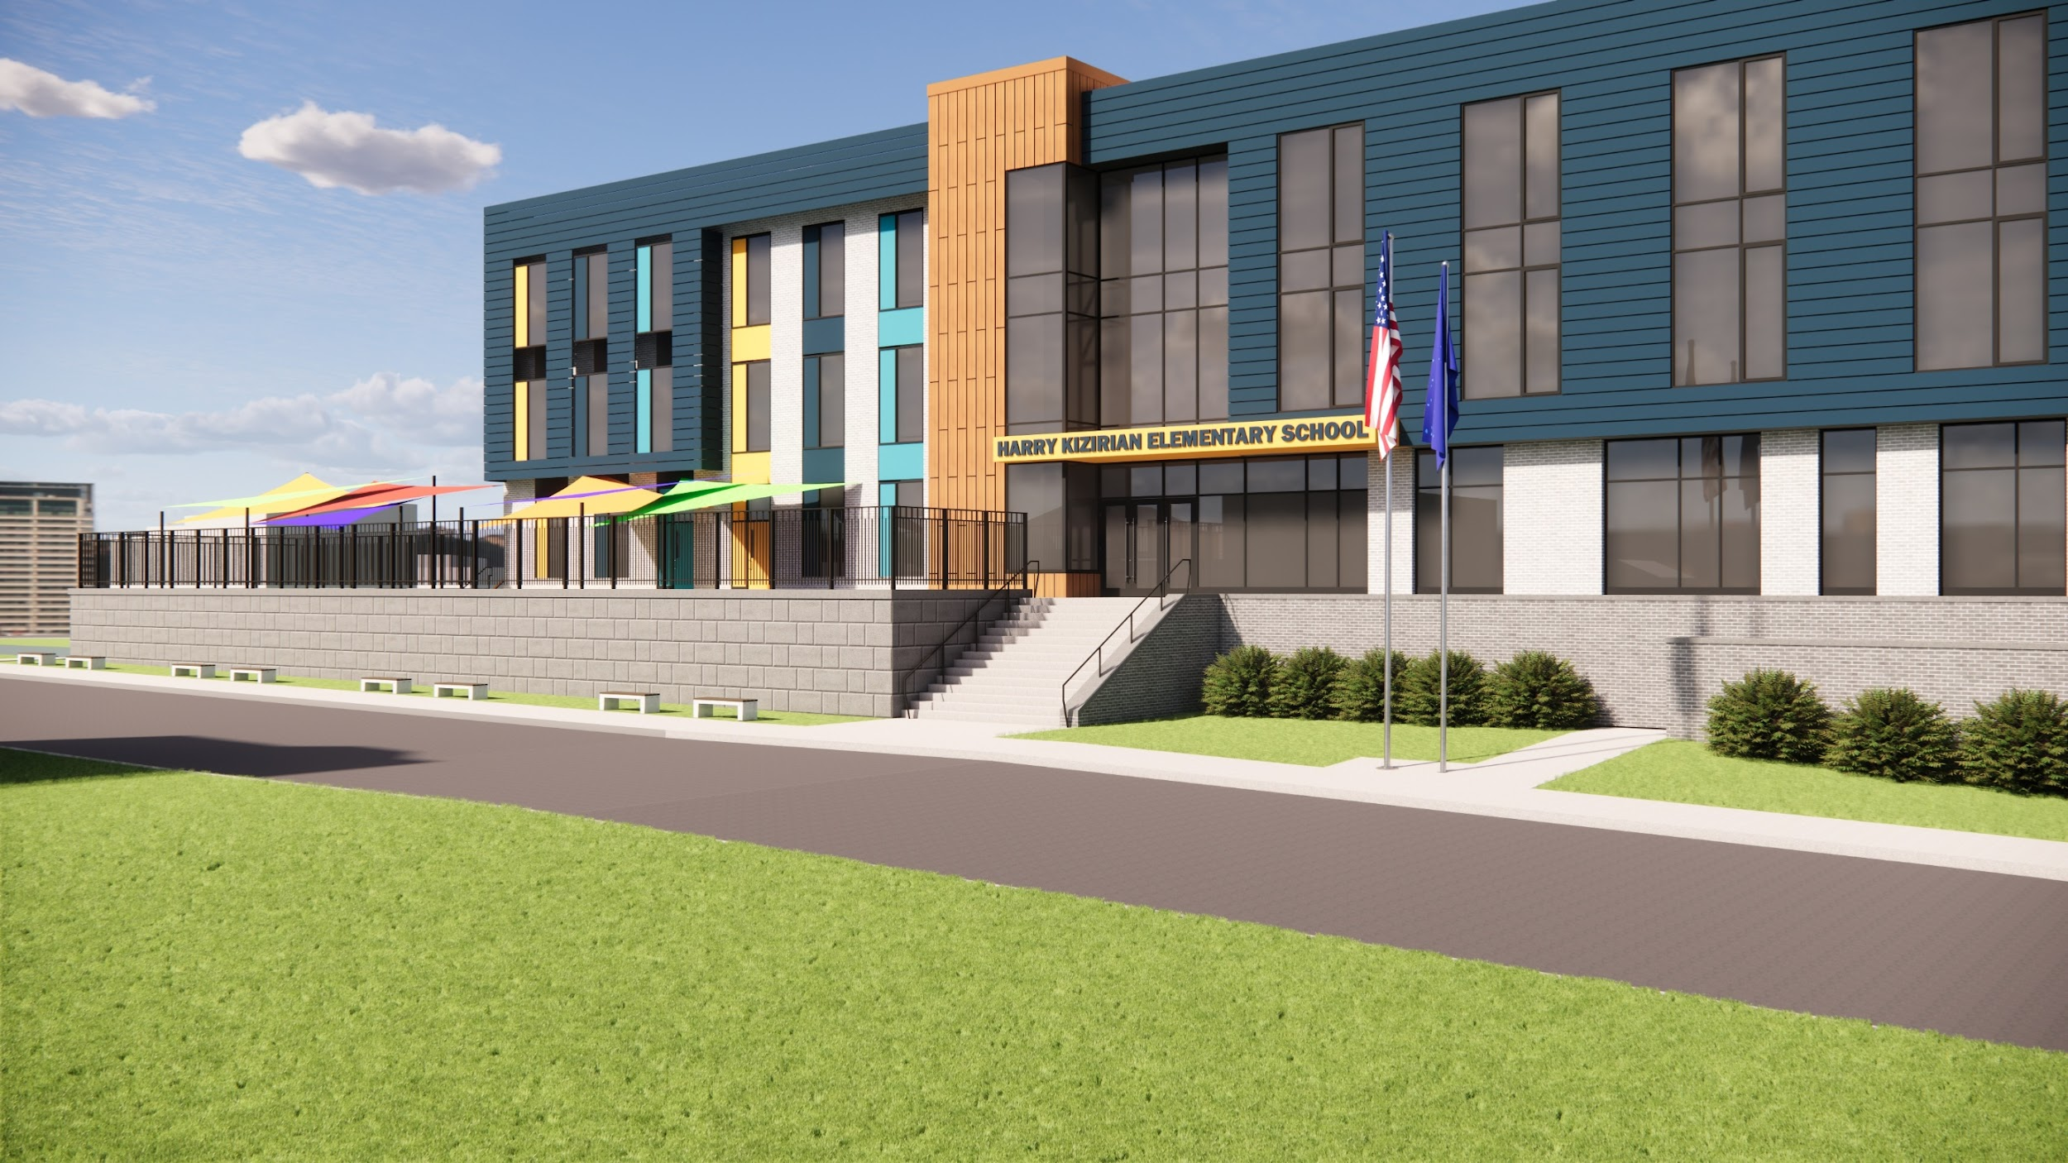
Phase 2 Projects Breaking Ground
Kizirian Elementary to PK-8, Fogarty Elementary to PK-8, and Spaziano Middle School for PK-8
Finalized design documents
On track for Summer 2026 completion
Swing space for Kizirian located at Narducci, Fogarty at Laurel Hill
Spaziano middle school to create PK-8 Dual Language campus
Placeholder for caption

Slide 12
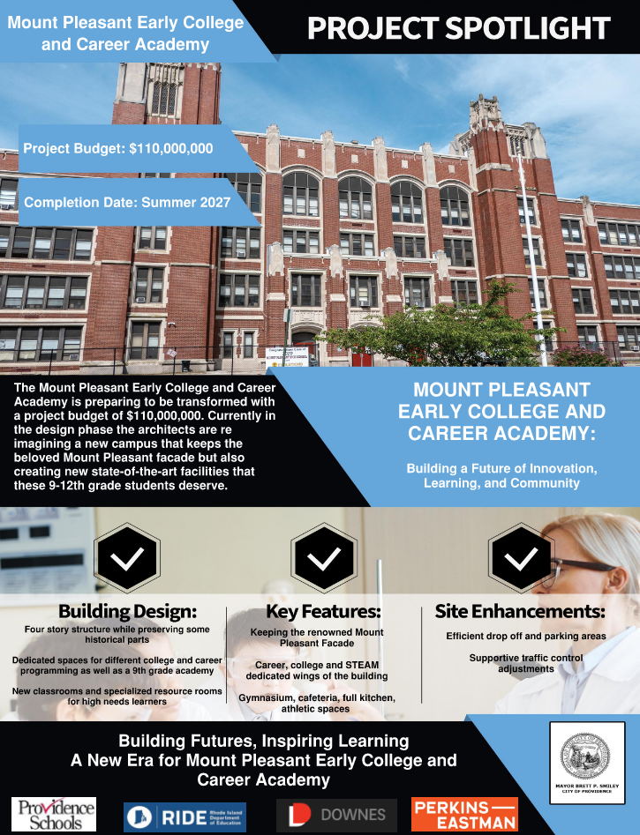
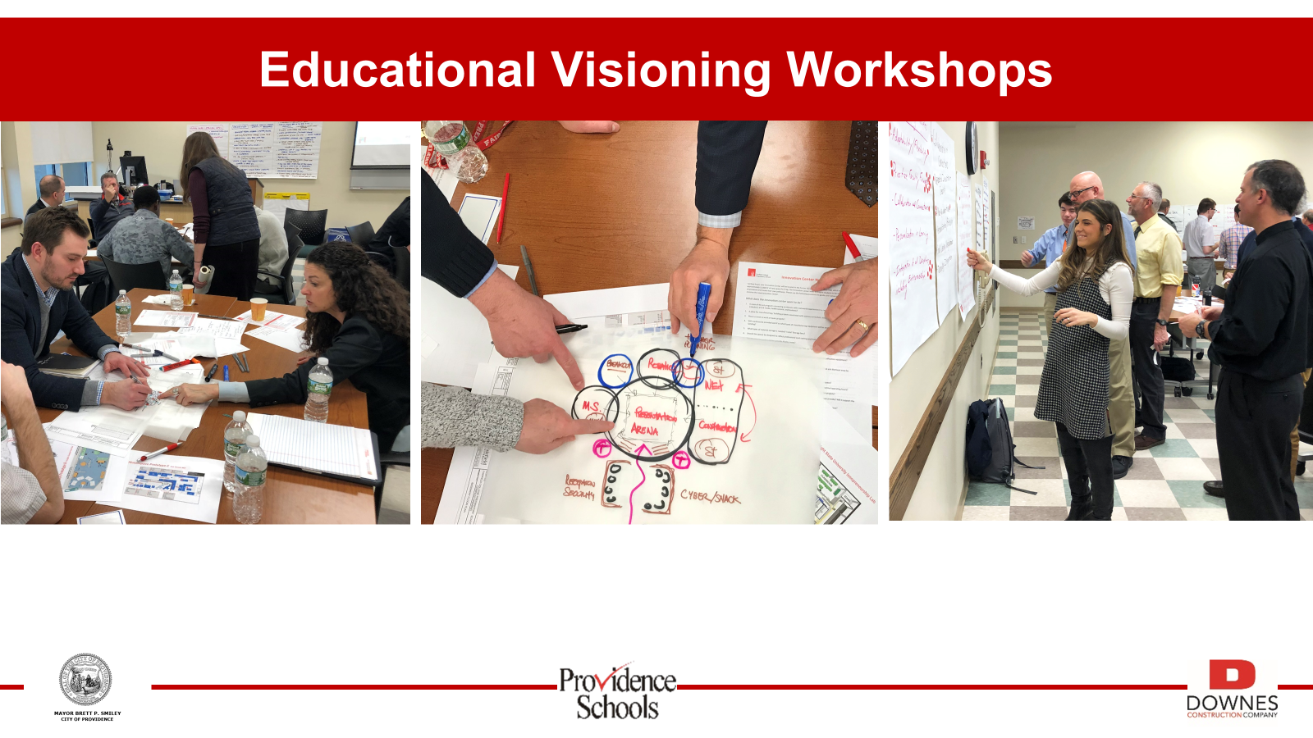
Phase 3 Projects in Engagement & Design
Alfred Lima dual language PK-8 at site of Stuart, Messer/West Broadway to PK-8, and Mount Pleasant High partial rebuild
Faculty engagement and school engagement through educational visioning sessions
On track to break ground Summer 2025

Slide 13
      Agenda
      Financial settlement with City of Providence
      Capital plan and swing space update
        Updates on Phases 1 – 3
        Swing Space planning
        Engagement and Next Steps

Slide 14
Capital Plan Phase 4: Projects Planned and Approved
Voters approved next phase of construction in November
Phase 4 provides once in a lifetime opportunity to dramatically expand access to new schools in Providence
Historic state reimbursement requires work to be completed on aggressive timeline with careful planning
PPSD began engagement early with School Board meeting in September and subsequent school/neighborhood engagement
Phase 4 Project List
New Build or Like-New Renovation
Roger Williams PK-8
Robert F Kennedy PK-8
Martin Luther King K-5 and Early Childhood Center
Nathaniel Greene PK-8
Hope High School
Vartan Gregorian K-5
Carnevale/DelSesto PK-8
Restore to New
Central High School
E-Cubed High School
Alvarez High School
Nathan Bishop 6-8
Bailey K-5
Young & Woods K-5
JSEC High School
Leviton Dual Language K-5
PCTA High

Slide 15
Swing Space Planning: What We’ve Done
In September we shared options, preliminary recommendations, and next steps regarding school construction with the School Board
What we shared
Swing space is critical as it is necessary for 6 of 13 remaining projects, including final phase 3 project Asa Messer
PPSD presented several options in September depending on available swing space
PPSD will explore potential school reconfigurations for PK-8 expansion as well as to create swing space
Merger of Asa Messer and West Broadway as part of Phase 3, with exploration of potential merger of Kizirian and Hopkins
What we have done since then
Joined 9 City Council ward meetings across the City in September and October as well as PTO meetings at schools with upcoming projects
  Letters to Hopkins and Kizirian families about potential merger
  Meetings with families and faculty members at Hopkins and Kizirian
Posted information on facility condition, enrollment information for Hopkins online
Detailed scheduling, programming, and facilities reviews with current enrollment information
Based on this information, we have revised recommendations for capital projects for next year, which includes some changes to preliminary recommendations shared in September.
We will engage communities further on these revised recommendations and communicate a final decision no later than January 10.

Slide 16
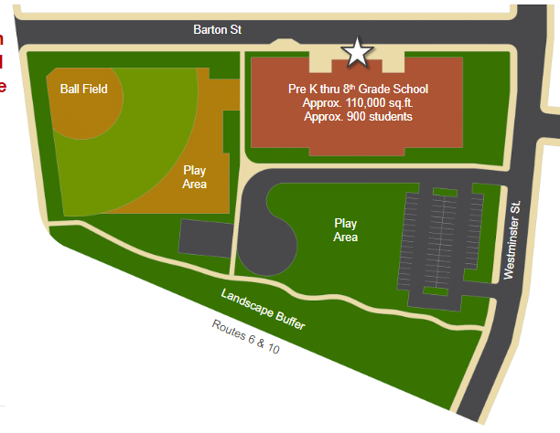
Swing Space Planning: Asa Messer
Carl Lauro identified as recommended swing space to house Asa Messer during construction
What did we consider?
Relocation of Asa Messer to a swing space for 2025-26 and 2026-27
Asa Messer is the final approved Phase 1-3 project that requires swing space, and already acts as a PK-8 community with WBMS
Recommendation
Based on size of school and neighborhood proximity, Carl Lauro identified as strong location for swing space
City received construction bids to perform building improvements for use as swing space through 2027 and beyond
Draft Site Plan for Asa Messer/West Broadway PK-8

Slide 17
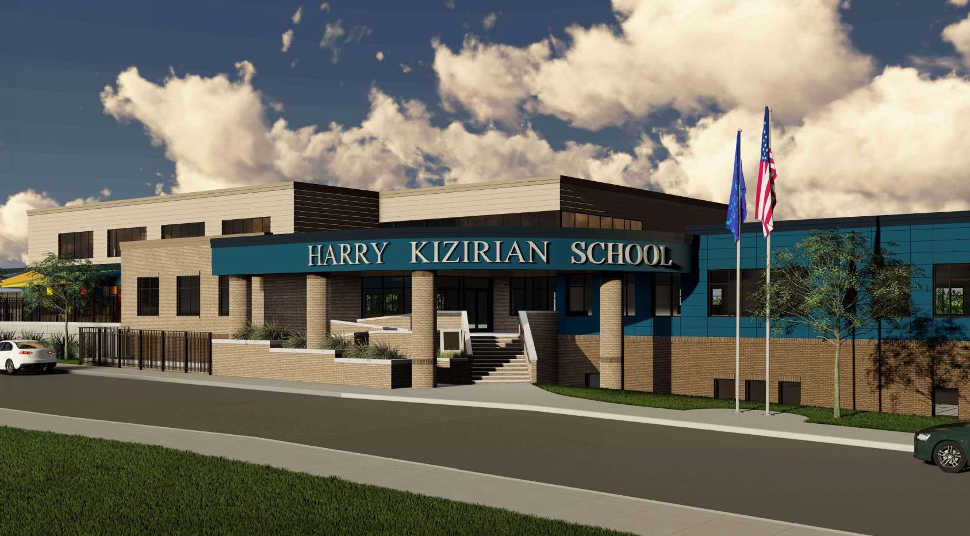
Swing Space Planning: Kizirian & Hopkins
Transitioning toward a PK-8 community and maximizing swing space
What did we consider?
Merge of Kizirian ES and Hopkins MS for 2025-26 school year, together at Narducci Learning Center and use of Hopkins middle school for swing space
Analyzed programs, enrollment, engagement with faculty and families
Findings
Hopkins cohorts are larger than is feasible to merge in the Narducci Learning Center without significant disruption to school programming
Merging the schools would not allow for aligned PK-8 programming (e.g., special education, MLL programming)
Recommendation
In 2025-26, Grade 5 students from Kizirian will grow in a Grade 6 cohort within Kizirian at Narducci
Hopkins will not merge with Kizirian and Hopkins Grade 7 and 8 to remain at Hopkins building
Feedback Themes
Questions about merging two separate schools without clear feeder pattern
Concerns about Hopkins students moving multiple times (to Narducci then to Kizirian)
Excitement about possibility of being in new space

Slide 18
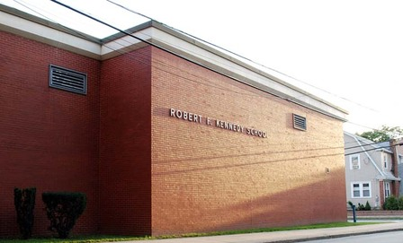
Swing Space Planning: Kennedy
Maximizing construction funding and moving toward an expanded Kennedy community
What did we consider?
Phase 4 projects must be completed by Summer 2028 to take advantage of time-limited funding bonuses
Phase 4 includes three PK-8 projects which need swing space: Kennedy, Williams, and Greene
Moving forward with Kennedy expands middle school options sooner
Findings
Kennedy elementary can relocate to Hopkins without disruption to academic programming as there is sufficient classroom space
Recommendation
In 2025-26 and 2026-27, Kennedy elementary will temporarily relocate to the Hopkins building as swing space while Kennedy is under construction
Kennedy will be co-located with Hopkins Grade 7 and 8
Enables ability to accelerate construction in order to meet state reimbursement deadlines

Slide 19
Recommended Swing Space Timeline
Maximize impact of funds and minimize disruption to students, expanded middle school options
Current recommendation: contingent on funding, community engagement, and design timelines
 | Narducci | Laurel Hill | Hopkins | Lauro (One Half)
2024-2025 | Kizirian PK-5 | Fogarty K-5 | Hopkins | Vacant
2025-2026 | Kizirian expands to Grade 6 (PK-6) | Fogarty K-5 | Kennedy K-5 & Hopkins Grades 7 & 8 (290/10) | Messer PK-4
2026-2027 | TBD | TBD | Hopkins Grade 8 (150/7) & Kennedy K-6 (520/22) | Messer PK-4
2026-2027
2027-2028
Kizirian PK to Grade 7 in new PK-8 building
Fogarty PK to Grade 6 in new PK-8 building
Kennedy in Hopkins, grows to K to Grade 6
Spaziano Dual Language in new 6-8 building
Laurel Hill & Narducci available for swing space
Messer & West Broadway in new PK-8 building
Kennedy PK to Grade 7 in new PK-8 building
Total of five PK-8 options for rising Grade 6 students in addition to four middle schools

Slide 20
      Agenda
      Financial settlement with City of Providence
      Capital plan and swing space update
        Updates on Phases 1 – 3
        Swing Space planning
        Engagement and Next Steps

Slide 21
Next Steps and Discussion
Activity | Timeline
Share recommendations with 3 impacted communities along with invitations for community meetings: Asa Messer Elementary, Kizirian Elementary, Hopkins Middle | 12/11-12/13
PTO and faculty meetings with impacted communities to gather feedback on proposed plans for next year | 12/11-12/13
Follow up meetings with PTO and faculty at affected schools to address questions or concerns raised | 1/2 – 1/8
Decision on plans for construction projects for 2025-2026 shared by PPSD leadership team with families and faculty members via community zoom, along with letters to families and school faculty | No later than 1/10

Slide 22
Appendix A – Financial Settlement

Slide 23
PPSD has had significant increases in student need that translate into additional, recurring costs
Increases from FY22 compared to FY25
Item | Cost
Differently Abled Students
Out of district tuition | $10.6M
Out of district transportation | $2.0M
Additional pre-K and special education classrooms | $3.0M
Pre-K evaluation teams and admin support | $2.8M
Multilingual Learners
Staffing (e.g., teachers, bilingual social worker, support staff) | $2.5M
Translation and interpretation services | $1.1M
Curriculum and professional development | $0.9M
MLL certification reimbursement | $0.8M
Total | $23.7M
Out of district tuition per student
In-district cost per student
Revenue per Student*
*Revenue for new pre-k enrollment typically lags by one year as funding is based on prior year enrollment

Slide 24
Potential Mitigation Steps
Due to cash flow issue likely arising in January without additional City funding, PPSD will need to take steps to mitigate budget shortfall in the coming weeks
Reduction | Estimated savings
Spending freeze - only allow supplies for basic school operations | ($252,652)
Overtime freeze – only allow overtime for emergency needs | ($244,950)
Central office administration hiring freeze | ($990,000)
5 furlough days for central office staff members, principals, and assistant principals | ($550,000)
Withdraw contribution to capital revolving fund | ($3,600,000)
Layoff non-union staff at schools | ($500,000)
Eliminate all athletic programming – winter and spring | ($1,700,000)
RIPTA - raise eligibility from 1 to 2 miles for remainder of year | ($735,000)
Eliminate ELL certification reimbursement | ($800,000)
Deeper school-based position cuts/freezes (e.g., eliminate 1 teacher assistant ECS/ASD/BIP classrooms) | ($2,624,000)
Subtotal | ($11,966,602)
Already in process

Slide 25
Appendix B – Capital Plan and Swing Space Update

Slide 26
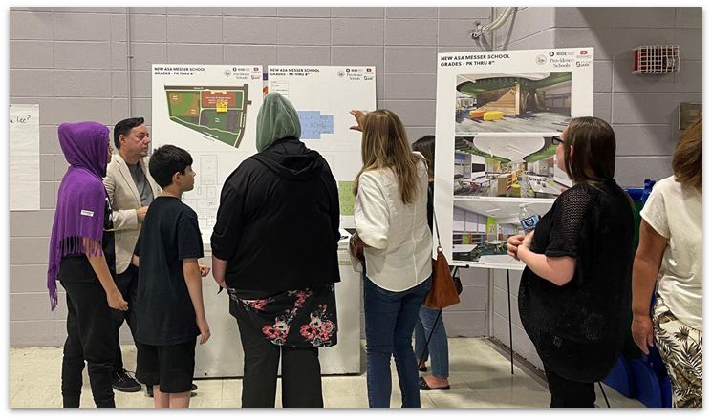
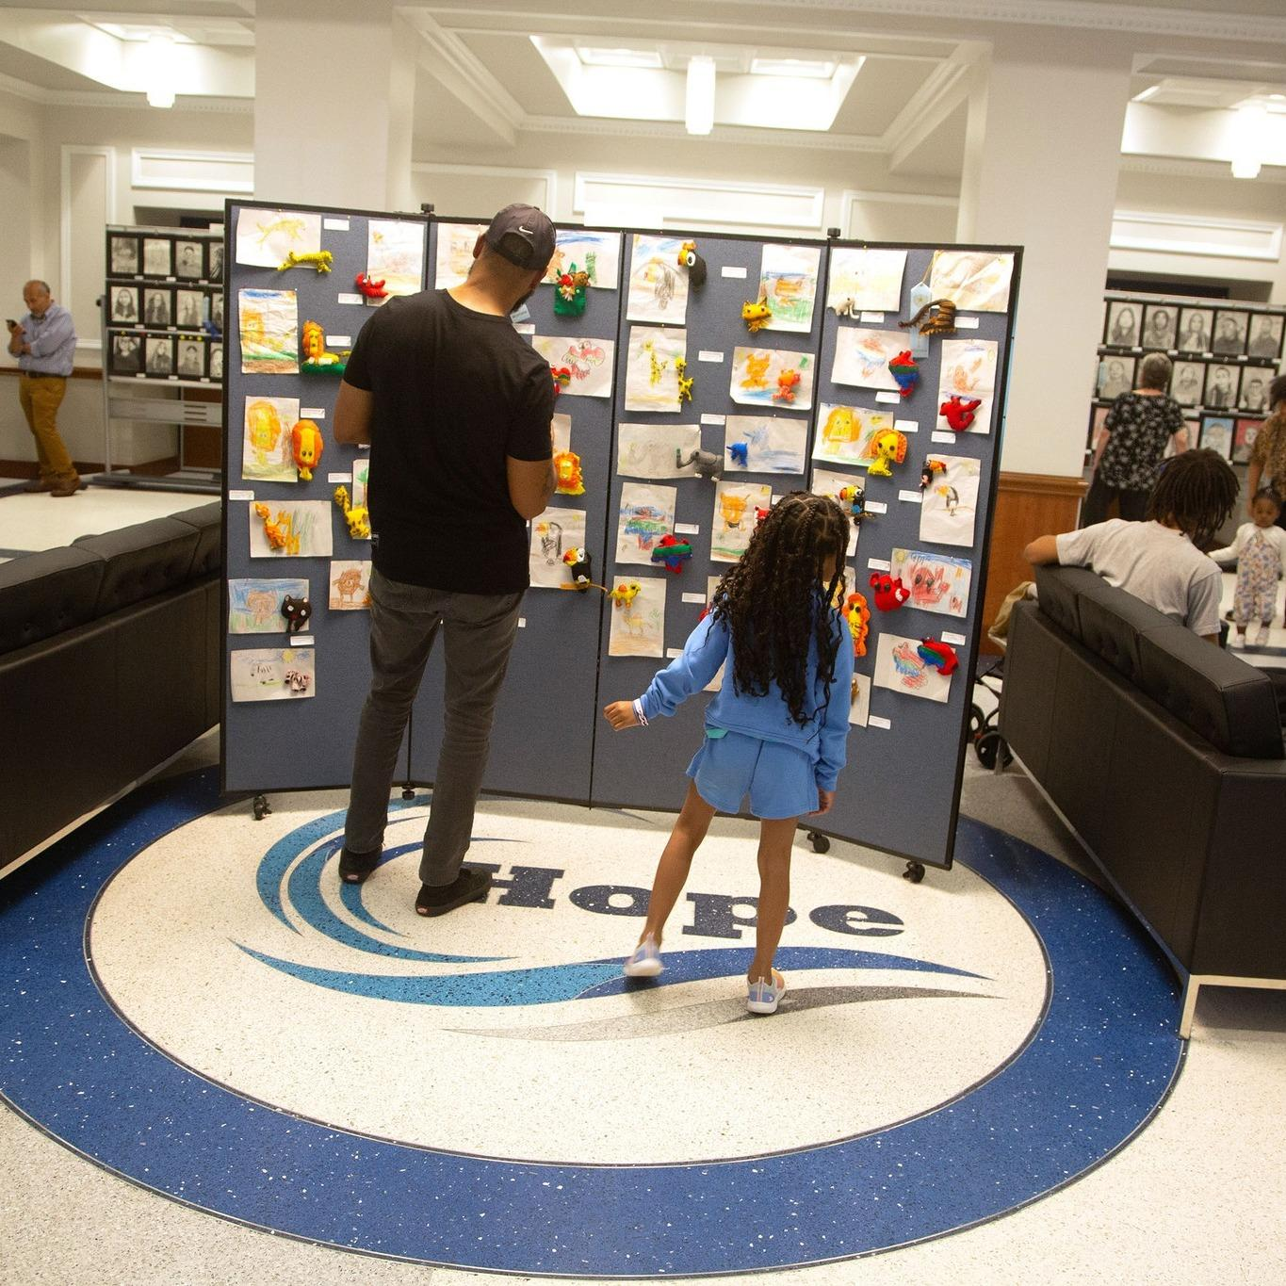
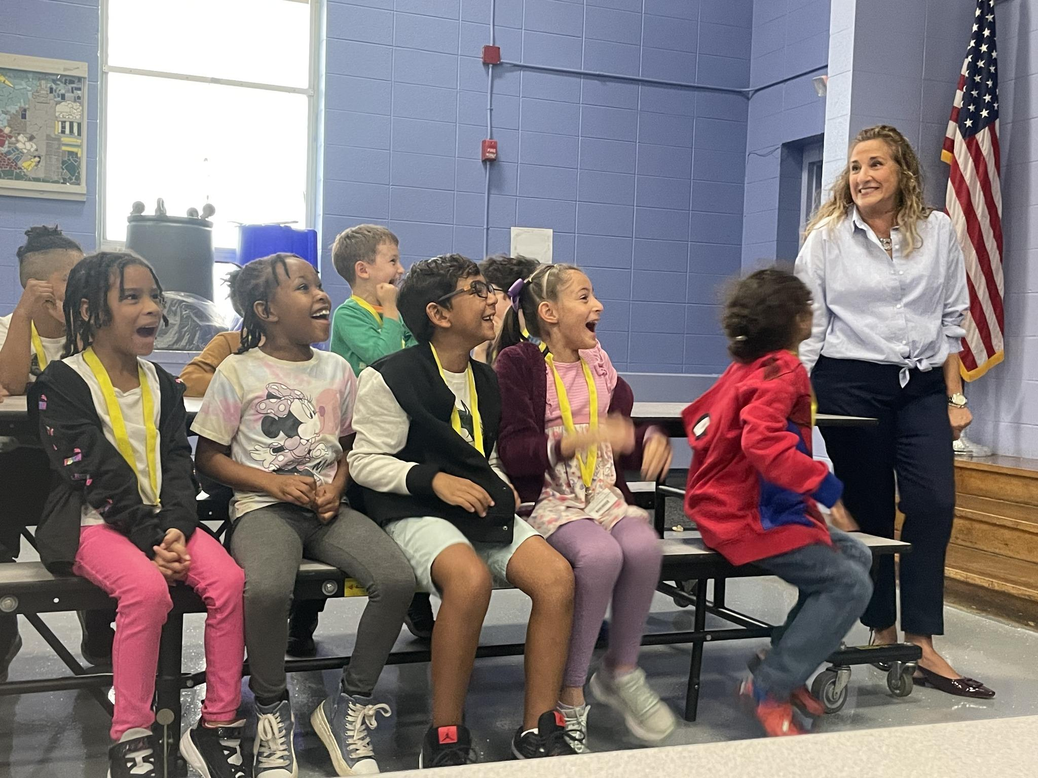
Community Engagement
Engagement sessions throughout the city in September and October, strong support for bond
Engagement this Fall
Partnered with City Council members on Ward meetings across the City in September and October
Joined PTO meetings at schools with upcoming projects
Led tours of new school buildings
Regular School Building Committee meetings with project updates
Updated website with newest projects and timelines
Upcoming Engagement
Continued updates on district websites and social media
Mount Pleasant HS, Lima/Stuart PK-8, and Messer/WBMS PK-8 educational visioning and design specifics with architecture and construction teams
School-specific updates at PTO and faculty meetings for swing space planning

Slide 27
Capital Plan Phase 4: Projects Planned and Approved
Approved by City Council and School Building Authority, going before voters in November.
New Build or Like-New Renovation
Roger Williams PK-8
Robert F Kennedy PK-8
Martin Luther King K-5 and Early Childhood Center
Nathaniel Greene PK-8
Hope High School
Vartan Gregorian K-5
Carnevale/DelSesto PK-8
Restore to New
Central High School
E-Cubed High School
Alvarez High School
Nathan Bishop 6-8
Bailey K-5
Young & Woods K-5
JSEC High School
Leviton Dual Language K-5
PCTA High

Slide 28
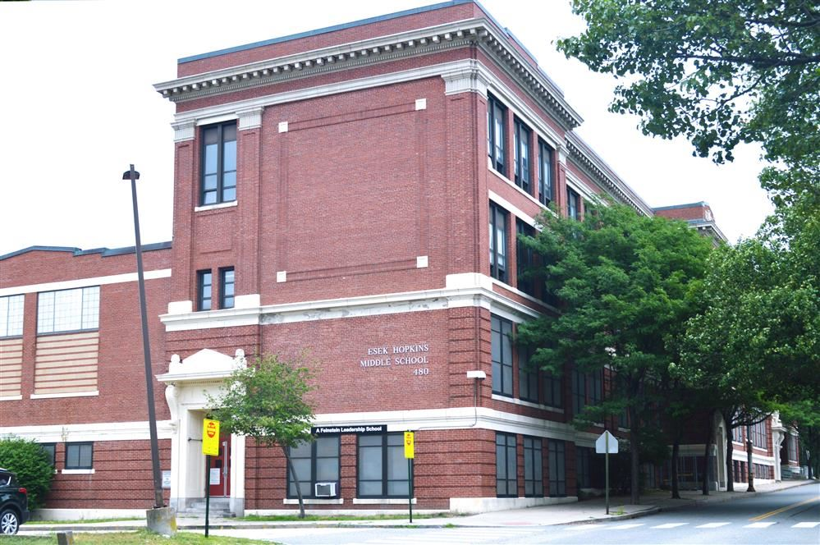
Hopkins Middle School
Responding to enrollment trends, supporting students and faculty
Enrollment context
393 students in 2023-24, down 35% (-214 students) over past 10 years
Enrollment at 66% of building’s capacity
Least chosen middle school for past four years
20 Grade 5 families selected Hopkins as first choice for 2024-25 (3% of students who submitted choices)
Facilities condition
Built in 1916
Estimated $27.7M in needed repairs
Second-lowest rated middle school facility after West Broadway
54% Facilities Condition Index, “Very Poor”

Slide 29
Current school
Swing
Identified future use
Potential future swing if needed
Possible Construction & Swing Space Timeline
Maximize impact of funds and minimize disruption to students
Option 1: No additional swing space from Lauro
 | Narducci ~850/33 | Laurel Hill ~570/22 | Hopkins ~750/29 | Lima ~900/28 | Summary of School Openings
2024-2025 | Kizirian (480/24) | Fogarty (420/20) | Hopkins MS (430/17) | Lima PK-5 | Pleasant View PK-5 opens
2025-2026 | Kizirian (550/24) & Hopkins (290/10) | Fogarty (400/19) | Messer (560/26) | Lima PK-5 | Kiziran/Hopkins merge into new PK-8 Spaziano Upper (6-8) opens
2026-2027 | Greene (800/30) | MLK (450/20) | Messer (560/26) | Lima PK-5 | Kizirian/Hopkins PK-8 at new building Fogarty PK-8 opens
2027-2028 | Greene (800/30) | MLK (450/20) | Kennedy (520/20) | Williams MS (820/28) | Messer/West Broadway PK-8 at new building Revitalized Mount Pleasant High School opens Lima/Stuart PK-8 opens
2028-29 | Permanent home to PPSD PK-8 or Phase 5 swing space | Vartan (300/17) | Kennedy (520/20) | Williams MS (820/28) | Greene PK-8 opens MLK PK-5 opens Williams PK-8 opens
2029-30 |  | Convert to park |  |  | Kennedy PK-8 opens Gregorian PK-5 opens

Slide 30
Current school
Swing
Identified future use
Potential future swing if needed
Possible Construction & Swing Space Timeline
Maximize impact of funds and minimize disruption to students
Option 2: Full Lauro building for swing space
 | Narducci ~850/33 | Laurel Hill ~570/22 | Hopkins ~750/29 | Lima ~900/28 | Lauro ~1,000/59 | Summary of School Openings
2024-2025 | Kizirian (480/24) | Fogarty (420/20) | Hopkins MS (430/17) | Lima PK-5 |  | Pleasant View PK-5 opens
2025-2026 | Kizirian (550/24) & Hopkins (290/10) | Fogarty (400/19) | MLK (450/20) & Vartan (300/17) | Lima PK-5 | Messer (560/26) & Kennedy (520/20) | Kiziran/Hopkins merge into new PK-8 Spaziano Upper (6-8) opens
2026-2027 | Greene (800/30) | Convert to park | MLK (450/20) | Lima PK-5 | Messer (560/26) & Kennedy (520/20) | Kizirian/Hopkins PK-8 at new building Fogarty PK-8 opens Gregorian PK-5 opens
2027-2028 | Greene (800/30) |  |  | Williams MS (820/28) |  | Messer/West Broadway PK-8 at new building Kennedy PK-8 opens MLK PK-5 opens Revitalized Mount Pleasant High School opens Lima/Stuart PK-8 opens
2028-29 | Permanent home to PPSD PK-8 or Phase 5 swing space |  |  | Williams MS (820/28) |  | Greene PK-8 opens Williams PK-8 opens
2029-30

Slide 31
Current school
Swing
Identified future use
Potential future swing if needed
Possible Construction & Swing Space Timeline
Maximize impact of funds and minimize disruption to students
Option 3: One half of Lauro for swing space
 | Narducci ~850/33 | Laurel Hill ~570/22 | Hopkins ~750/29 | Lima ~900/28 | Lauro (One Half) ~530/30 | Summary of School Openings
2024-2025 | Kizirian (480/24) | Fogarty (420/20) | Hopkins MS (430/17) | Lima PK-5 |  | Pleasant View PK-5 opens
2025-2026 | Kizirian (550/24) & Hopkins (290/10) | Fogarty (400/19) | Kennedy (500/20) | Lima PK-5 | Messer (560/26) | Kiziran/Hopkins merge into new PK-8 Spaziano Upper (6-8) opens
2026-2027 | Greene (800/30) | MLK (450/20) | Kennedy (520/20) | Lima PK-5 | Messer (560/26) | Kizirian/Hopkins PK-8 at new building Fogarty PK-8 opens
2027-2028 | Greene (800/30) | MLK (450/20) | Vartan (300/17) | Williams MS (820/28) |  | Messer/West Broadway PK-8 at new building Kennedy PK-8 opens Revitalized Mount Pleasant High School opens Lima/Stuart PK-8 opens
2028-29 | Permanent home to PPSD PK-8 or Phase 5 swing space | Convert to park |  | Williams MS (820/28) |  | Greene PK-8 opens MLK PK-5 opens Gregorian PK-5 opens Williams PK-8 opens
2029-2030

