Slide 1





Briefing for Providence Public Schools
January 2024
1
Copyright © 2021 MSA Management, LLC/Ginn Group Collaborative All Rights Reserved

Slide 2

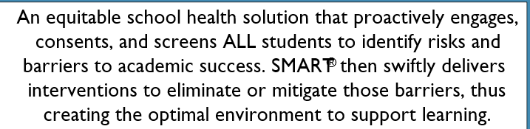
Copyright © 2021 MSA Management, LLC/Ginn Group Collaborative All Rights Reserved
Notes:
Greetings

Slide 3
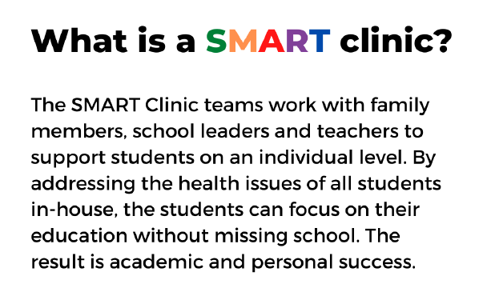
What Makes a
SMART® School Model Unique?

Slide 4

Knowing The Whole Child, Every Child
90% of an iceberg is below the waterline and thus invisible
The Known
Diagnosed Illness/IEP
Attendance
Externalizing Behaviors
Poor Hygiene
Poor Grades
Some Risky Behaviors
Personal Health Costs
Medical Costs
Pharmaceutical Costs
10%
10%
The Unknown
ADHD
Anxiety
Bullying
Depression
Presenteeism
Poor Nutrition
Family Problems
Suicide Ideation
Chronic Diseases
Language and Cultural Barriers
Unmanaged Diagnosed Illnesses
Risky Behaviors and Relationships
Hidden Costs
System and Institutional Costs Associated with Undiagnosed or Preventable Illness
90%
90%
Copyright © 2021 MSA Management, LLC/Ginn Group Collaborative All Rights Reserved
Notes:
Reason for completing health risk assessments.

Slide 5
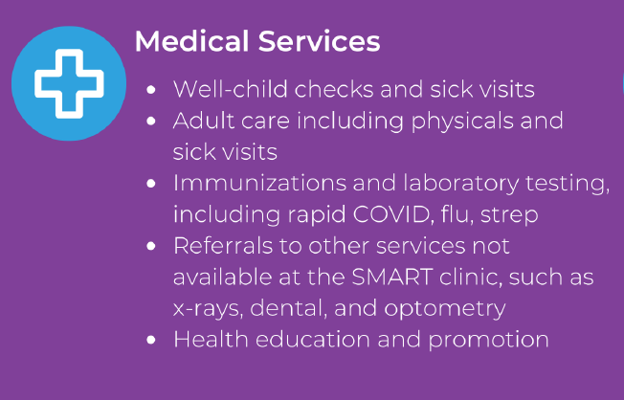
SMART collaborates with School Nurse Teacher (SNT) to see students who need additional medical / behavioral services. Provides coverage when SNT is unavailable. Works with SNT to help meet school metrics.

Slide 6
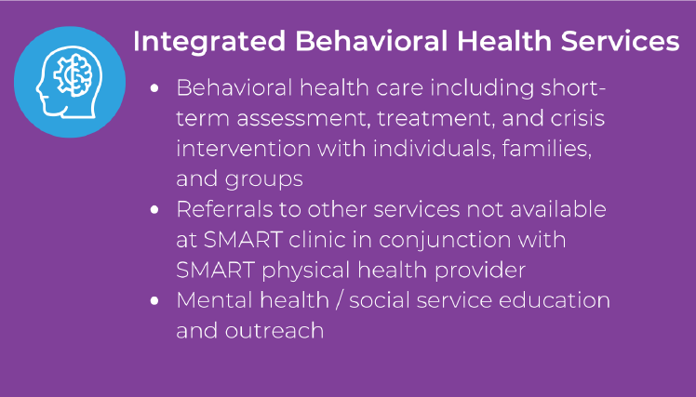
SMART clinics have integral behavioral health providers at all clinics. They attend the multi-tiered system of supports (MTSS) to maximize student achievement and support students social, emotional, and behavior needs from a strengths-based perspective.

Slide 7

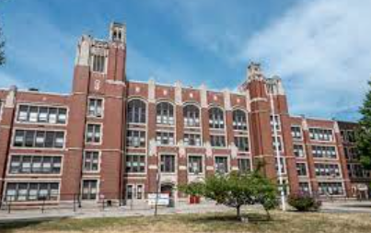
Mount Pleasant Early College and Career Academy

Slide 8
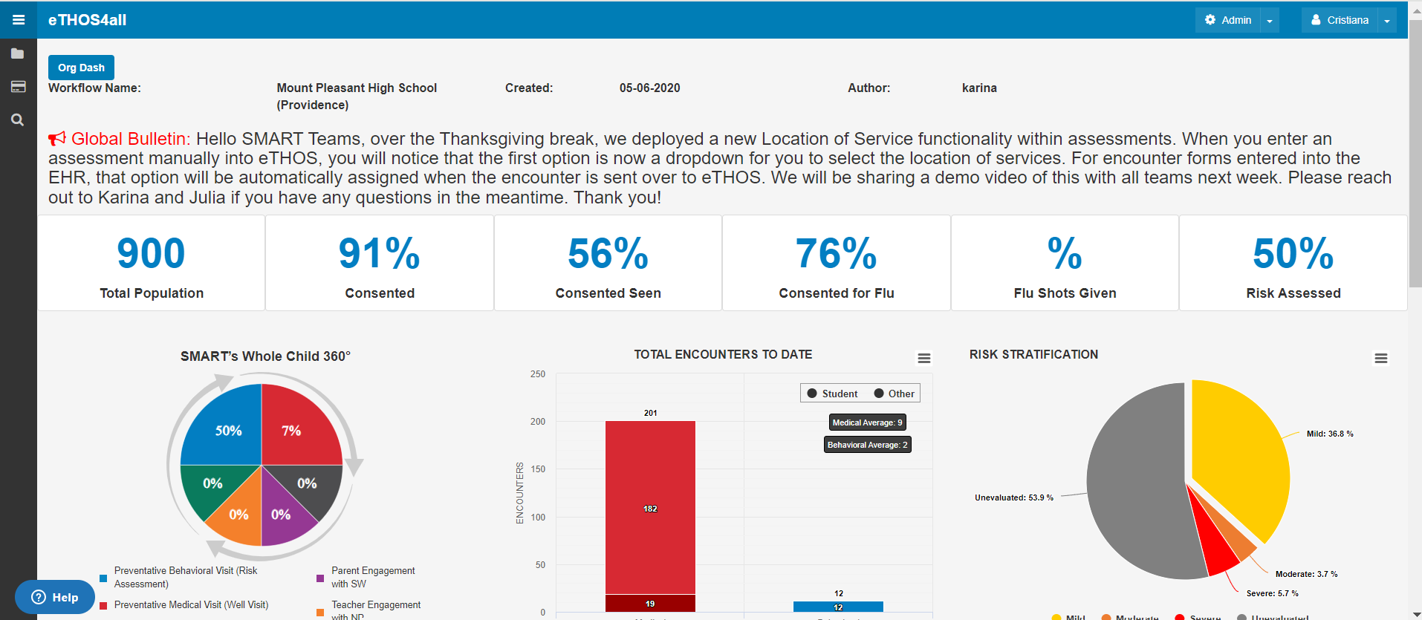
Notes:
The SMART clinics provide metrics to GINN group when completing health risk assessments. This year clinics are completing the ABC 30 which are age based questions addressing social determinants of health ( safety, health, behavioral health, gun safety, food insecurities, dental, bullying etc.) information on the above slide are incomplete. PCHC converted to EPIC this year and ETHOS system communication with EPIC has not been finalized. Flu shots are not being picked up yet.

Slide 9
SMART Mount Pleasant
Total student population: 900
Flu vaccines administered 216
Risk assessments to date 429
Total encounters of students as of 12/2023 942

Slide 10
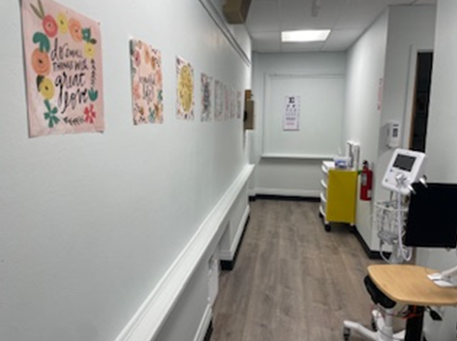
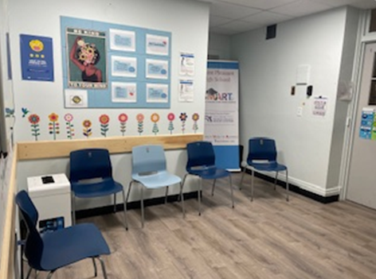
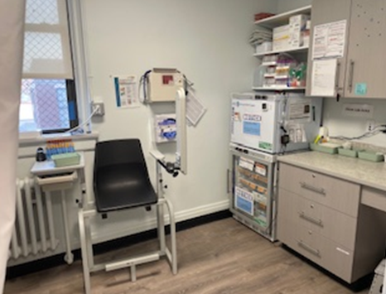
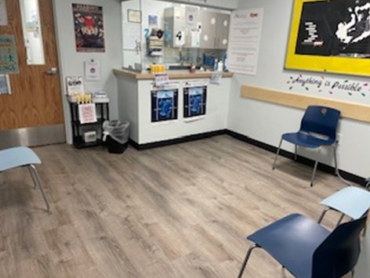
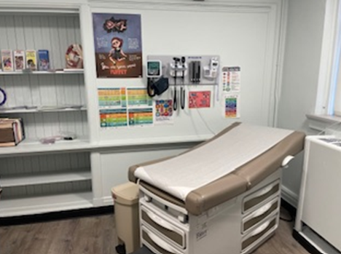
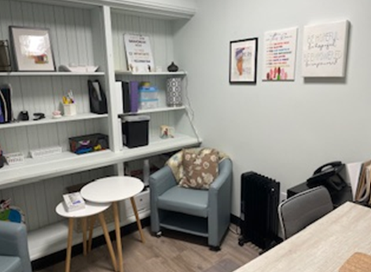

Slide 11
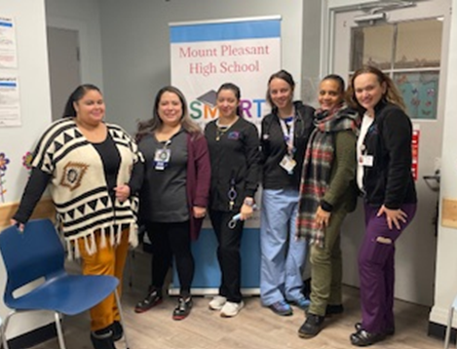

Slide 12
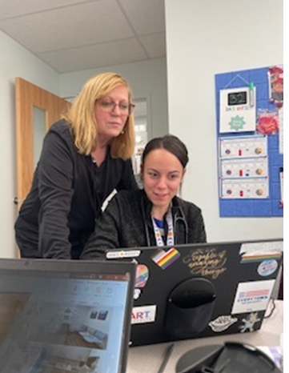
“The name of the game in schools is attendance, getting our students in school and keeping them there. That is how we make change and move them forward. The collaboration between the Smart clinic at MPHS and the school nurse helps to ensure the movement forward. Life can be absolutely challenging for our teens and this collaboration gives them the net they need to succeed at school - we address there medical and emotional needs at school. Our collaboration makes that a reality.”
Barbara Rios, RN, CSNT
Mount Pleasant Early College and Career Academy

Slide 13
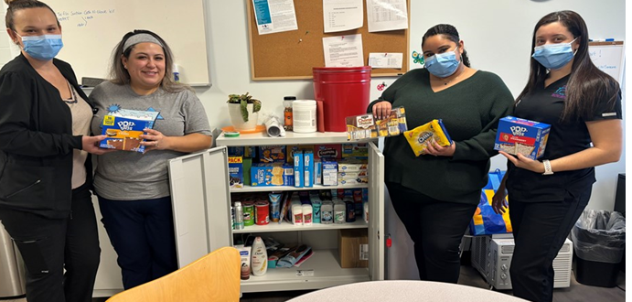
SMART PANTRY DONATIONS BY LOOMIS AND CVS JUNTOS

Slide 14

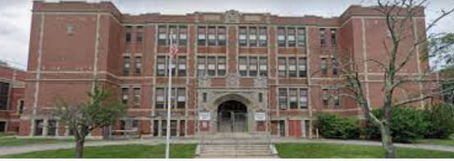

Slide 15
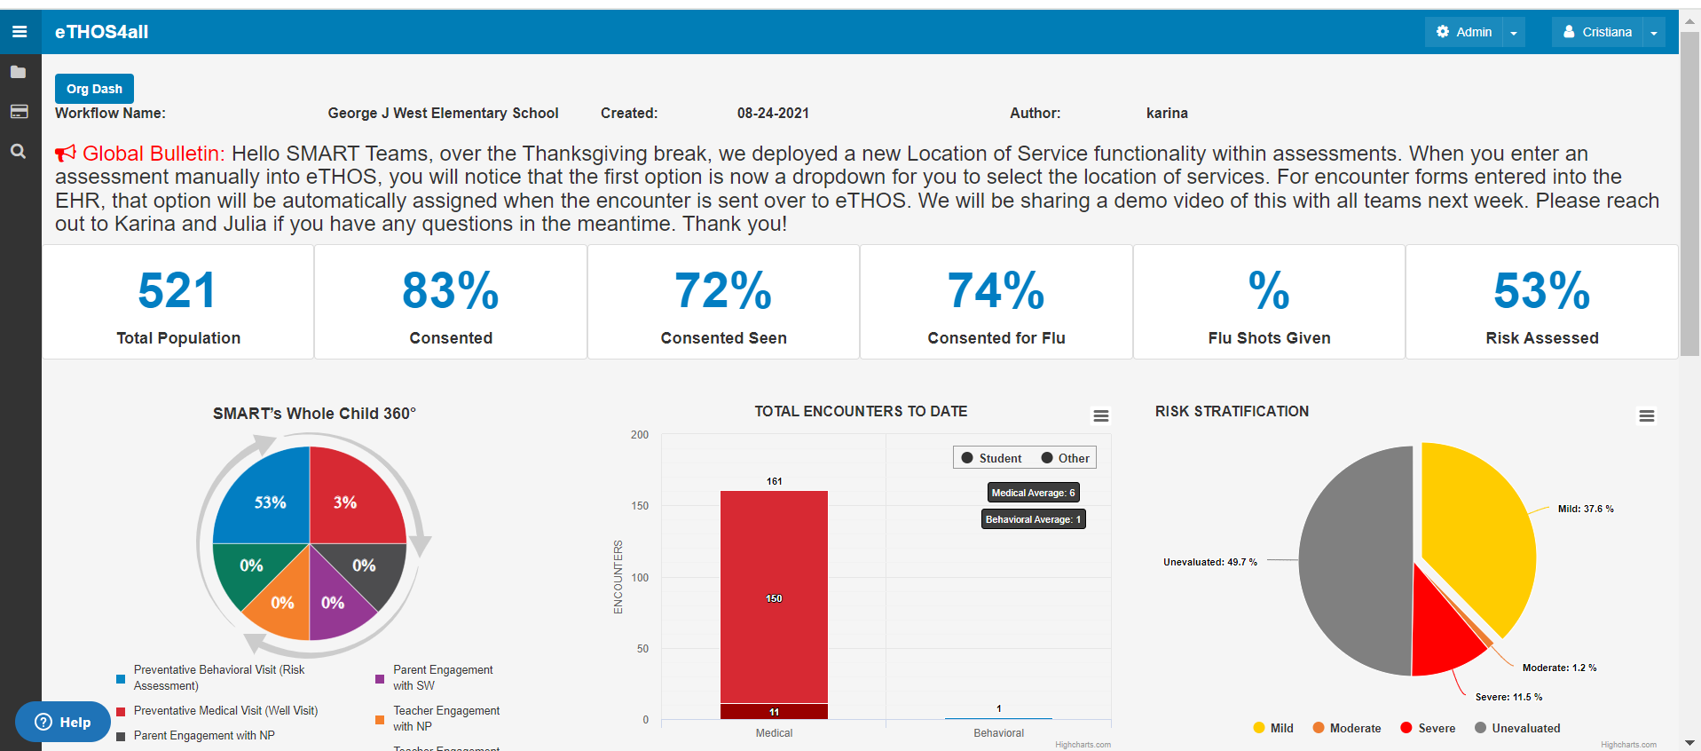

Slide 16
SMART George J West
Total Student population 521
Flu vaccines administered 185
Risk assessment to date 273
Total encounters of students as of 12/2023 649

Slide 17
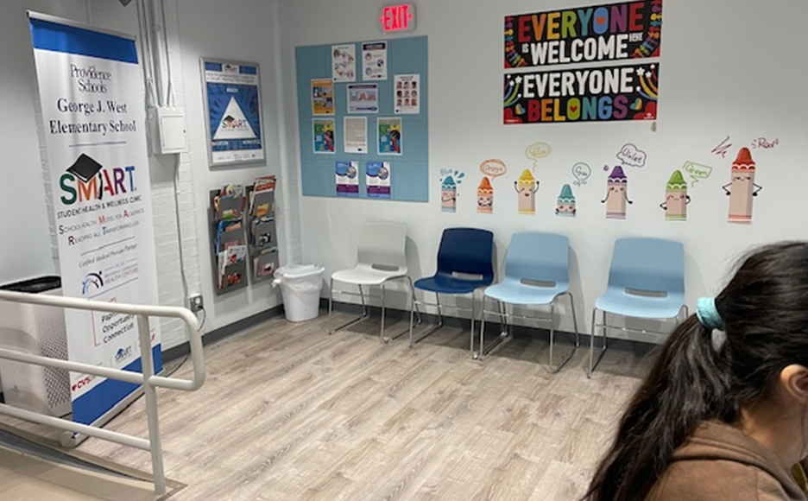
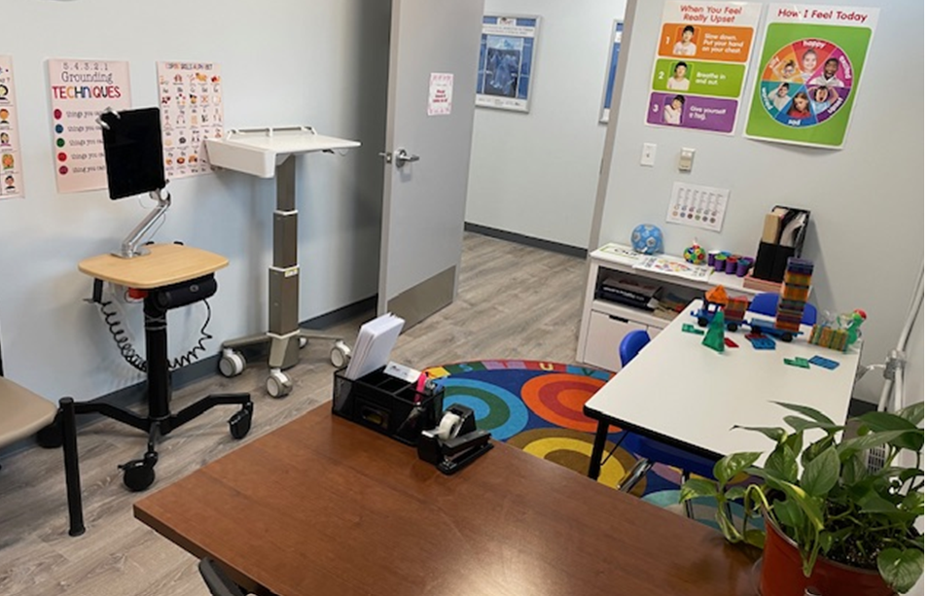
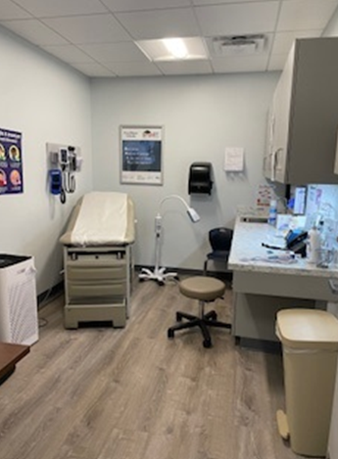
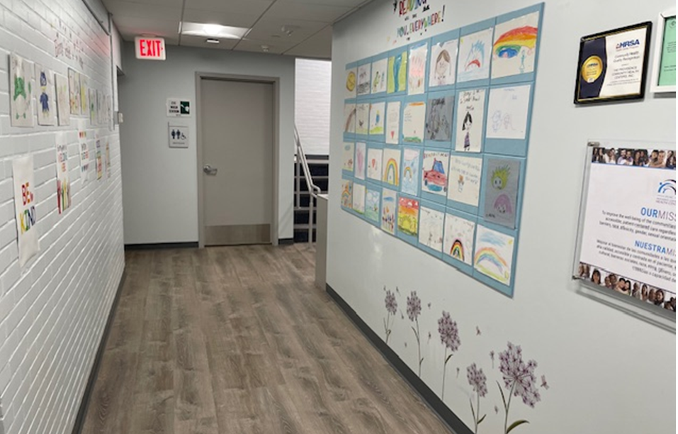

Slide 18
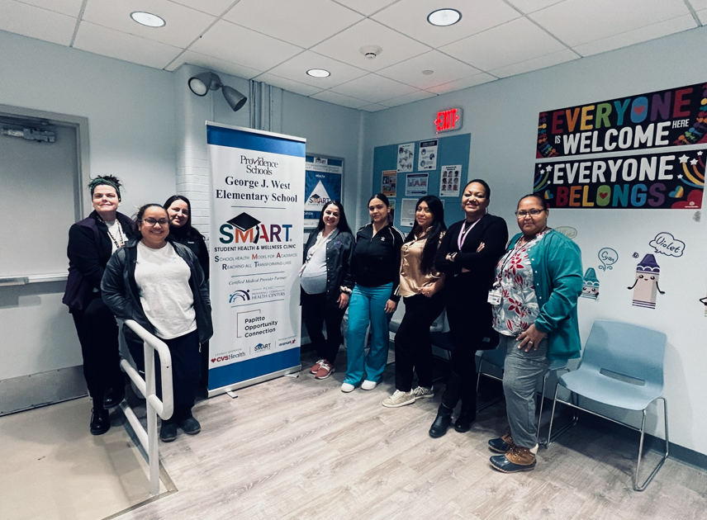
“The SMART clinic is a great resource for students and our school staff. I like the support that they provide to the students and for me.” Collen O’Donnell, RN, school nurse teacher at George J West Elementary.

Slide 19
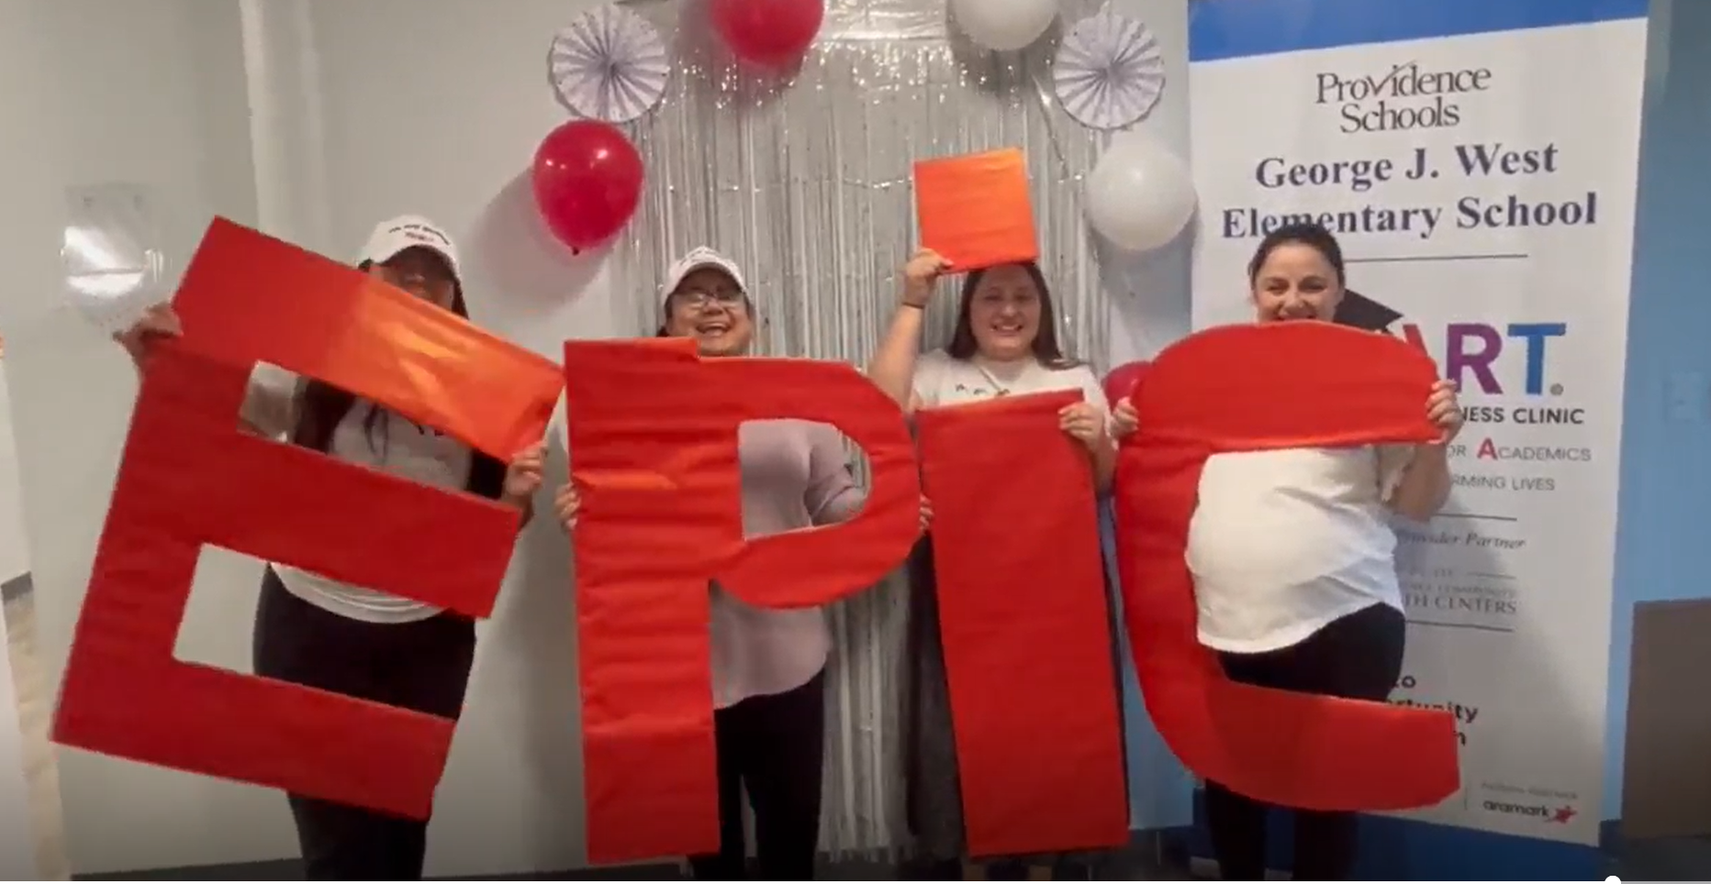


Books Are Wings and Donations for Food Pantry CVS and Loomis

Slide 20

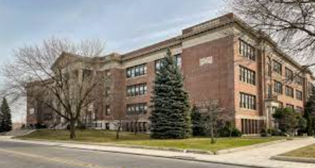
Roger Williams Middle School

Slide 21
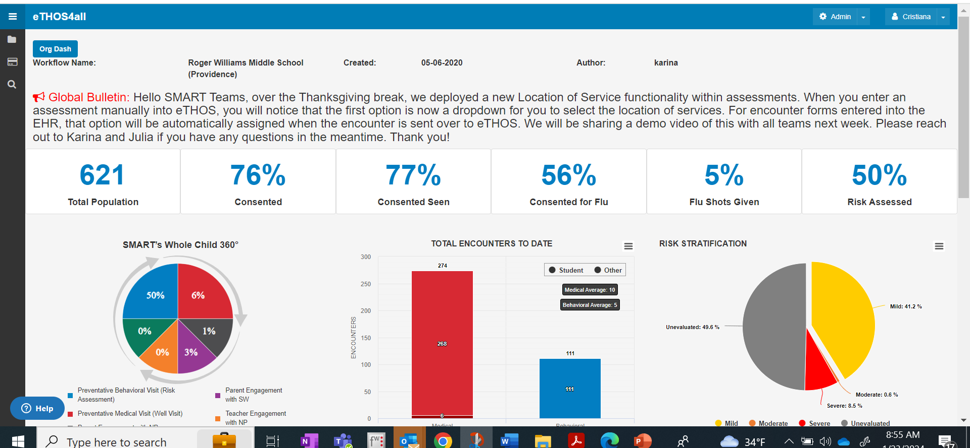

Slide 22
SMART Roger Williams
Total student population 621
Flu vaccines administered 195
Risk assessments to date 358
Total encounters of students as of 12/2023 total 1129

Slide 23
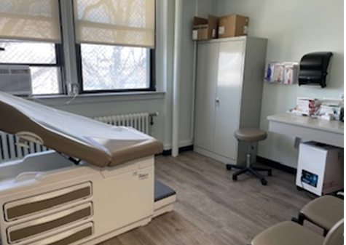
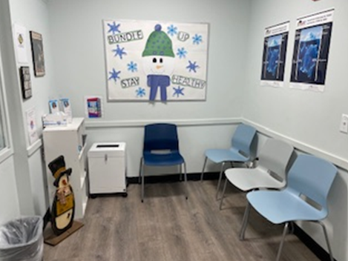
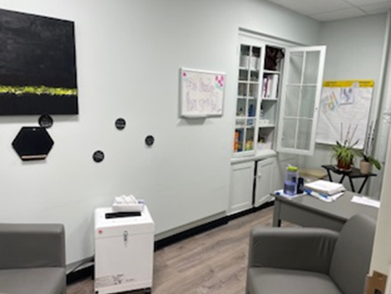
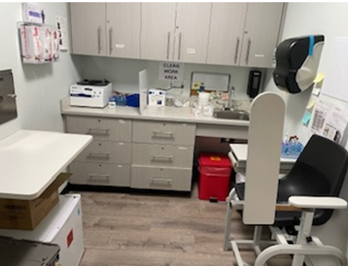

Slide 24



Slide 25
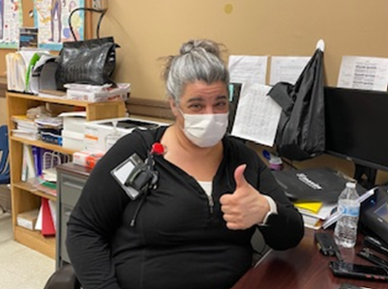
“Working with SMART clinic is always a positive. I know that when the students are sent to the SMART clinic they will be cared for and treated. The SMART clinic calls the student’s parents and the students don’t have to sit in the nurse’s office waiting for their parents to come pick them up.”
Michelle Domenico, SNT
Roger Williams Middle School

Slide 26

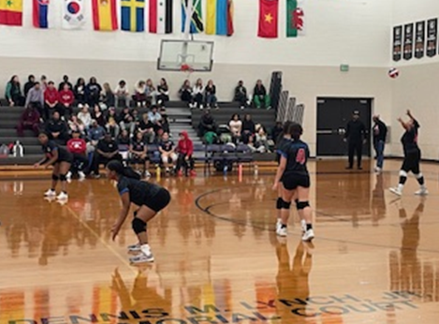
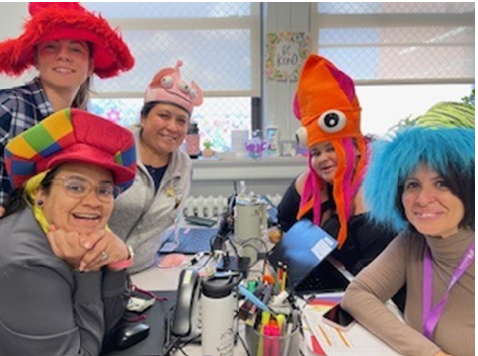
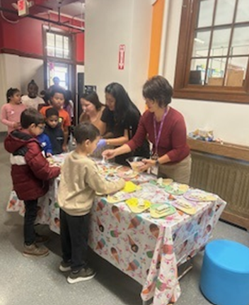
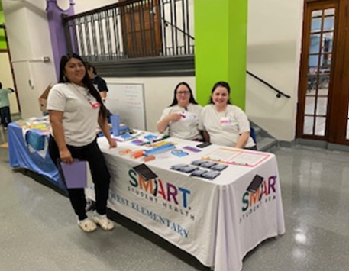
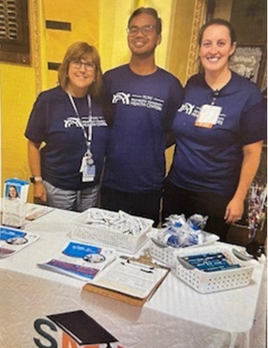
SMART School Engagement

